Slide 1
Housekeeping
Do not take screenshots of the presentation or chat box
Do not use any recording software or equipment during the presentation. This includes the use of Artificial Intelligence (AI) technology
Be present and engage with the webinar opportunities, such as live polls, chats, and surveys
Be respectful to others and behave professionally
Do not use foul or offensive language when communicating with fellow attendees and speakers
Do not share weblinks to join the webinar with others. This is a closed webinar for selected participants only.
Your behaviour should not damage the good name of the CSC

Slide 2
CSC Mentoring Programme
Information session for prospective Mentors

Slide 3
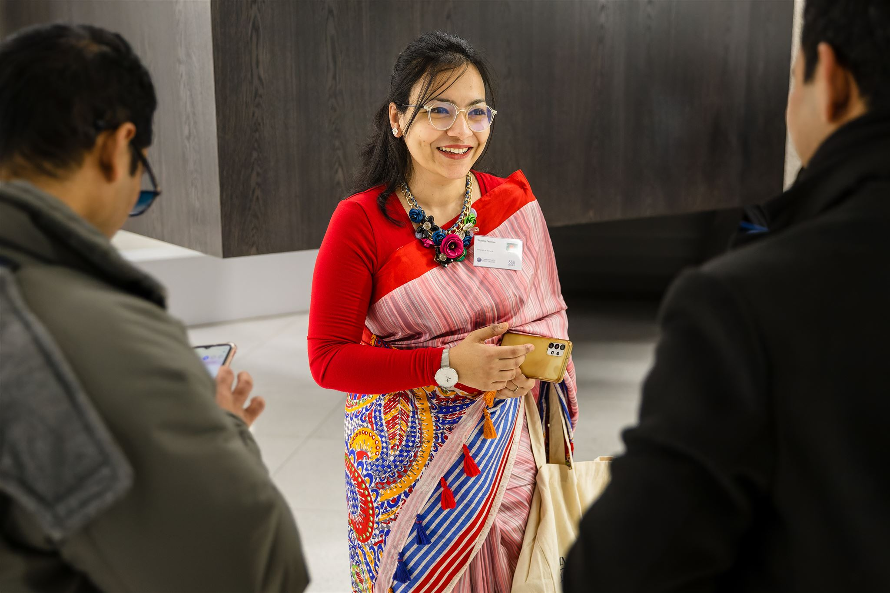
Information session
Overview
Introduction to the programme
Roles and responsibilities of Mentors
Benefits of taking part
How the programme works
Resources
How to apply
Learn from participating Mentors
Q&A

Slide 4
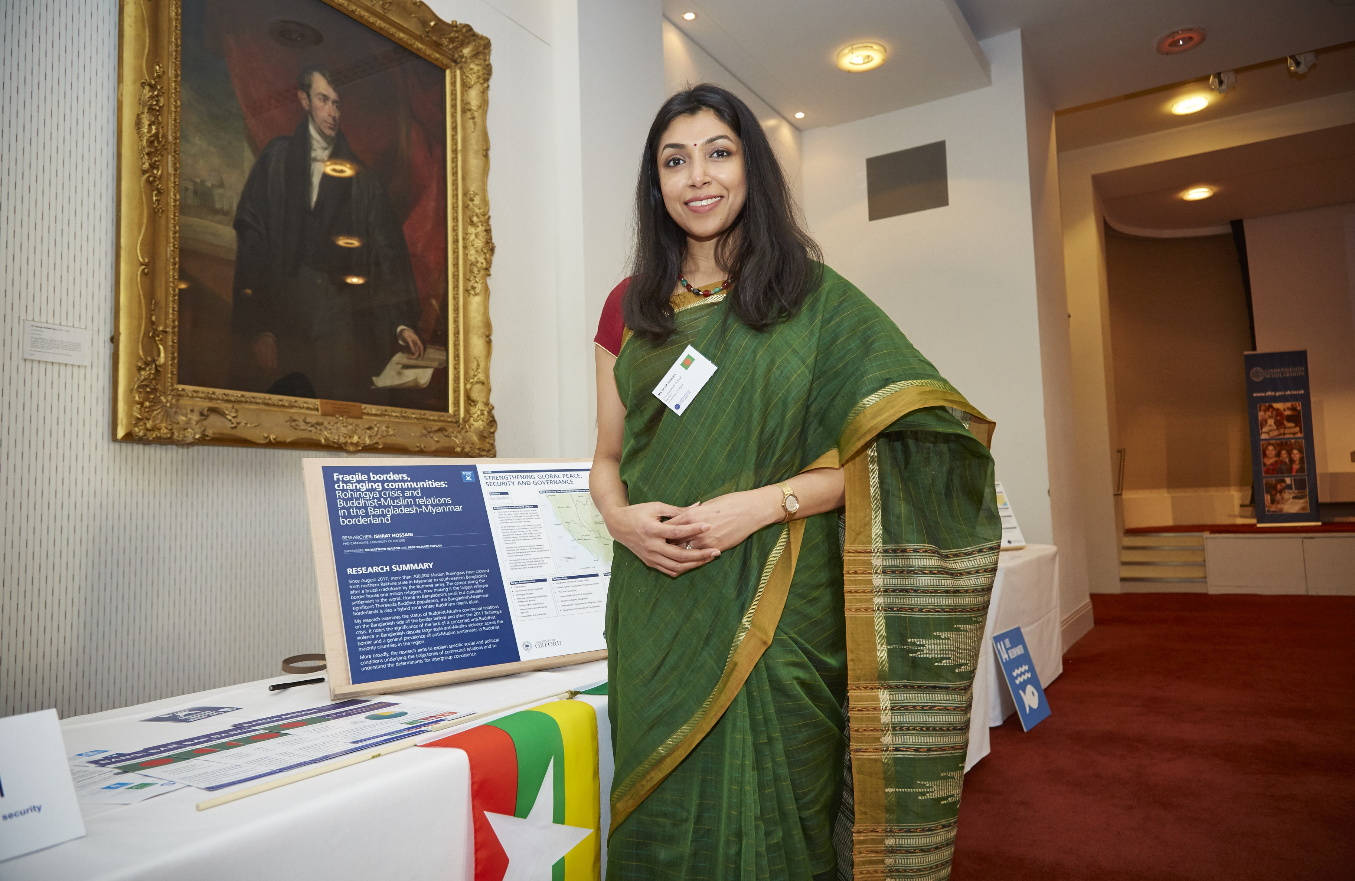
Mentoring Programme in numbers
Since 2019, over 650 Commonwealth Scholars and Alumni have participated in the CSC Mentoring Programme
Home-country and cross-country pairings
Year-long programme from December 2023 to December 2024
Master’s and doctoral mentees

Slide 5
The programme aims to:
Connect Commonwealth Scholars and Alumni
Share knowledge and enhance skills development
Increase understanding of how to achieve development impact post-Scholarship
Provide Scholars with advice and guidance on studying and living in the UK
Develop mentoring and other soft skills

Slide 6
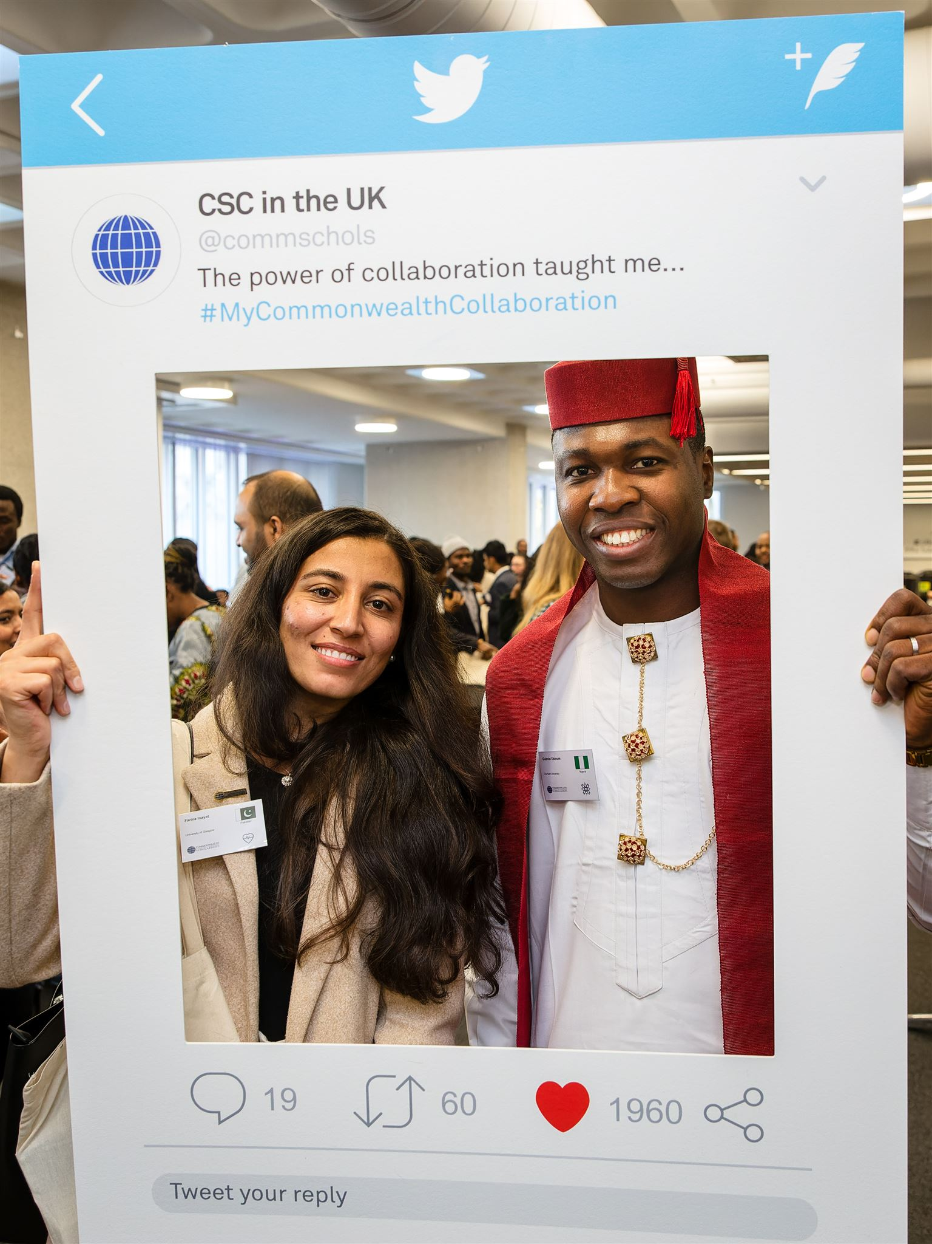
Roles and responsibilities of Mentors
Support a new Scholar in developing the appropriate skills and knowledge
Share your skills and expertise
Provide guidance on implementing learning and skills post-Scholarship
Develop your own mentoring and professional skills
Encourage your Mentee to stay connected with the CSC community

Slide 7
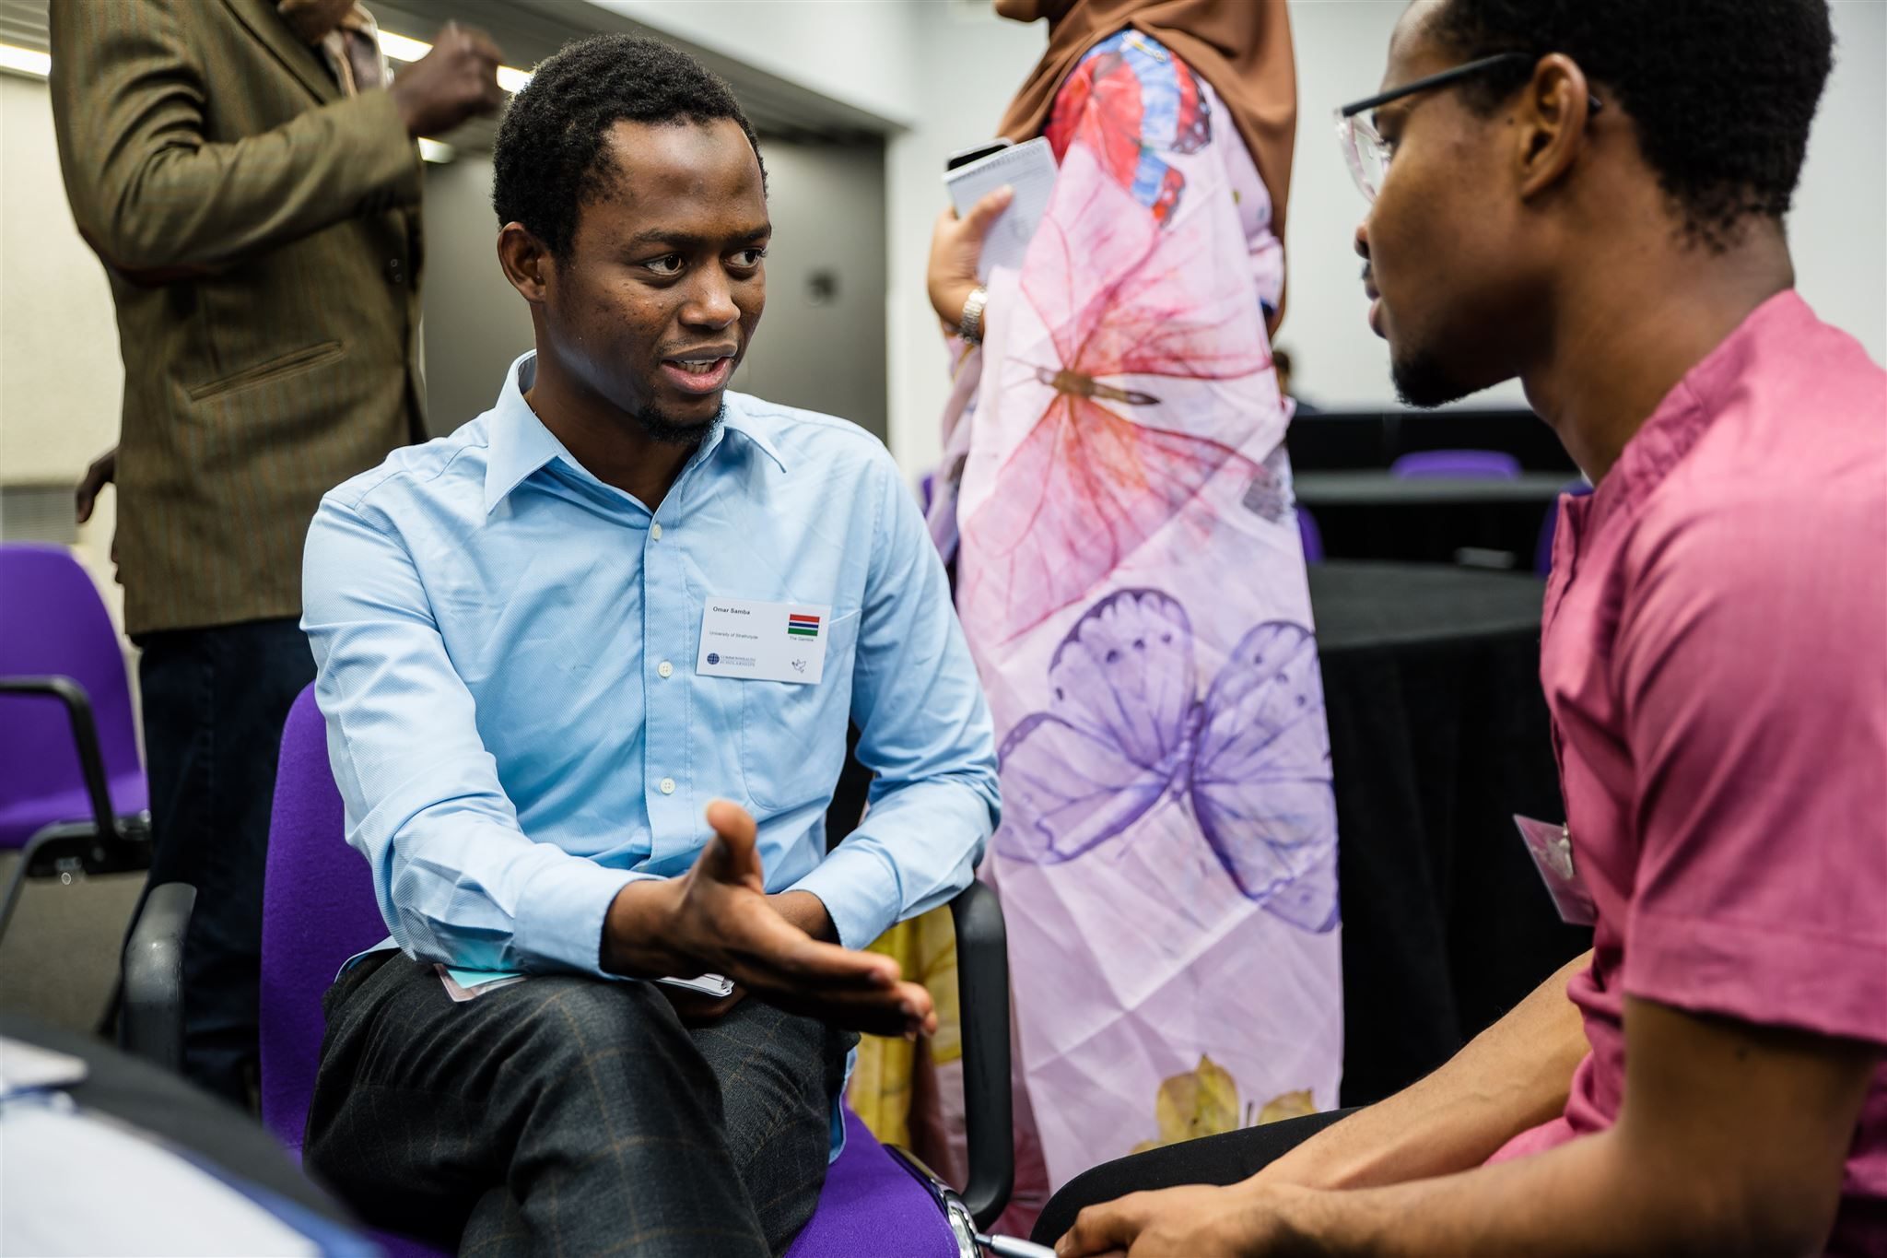
Benefits of taking part
Continue being connected with the CSC
Share your own experiences
Develop mentoring and professional skills
Knowledge exchange, understanding cultures
Collaborate on research, work projects
Notes:
TLP activities have included; professional fellowship programme focussed on the specific topic (Girls’ Education; Clean Energy, Air & Oceans, LGBT+ Rights), ACEF funding, internal staff disability confidence training, disability support package, website and application route accessibility audit, appointing additional agencies for specific application routes.

Slide 8
How the programme works
How the programme works
Minimum 2 hours time commitment
Five stages
Set short- and long-term goals the SMART way
Provide academic, professional, and social support
Thinking beyond academics – development impact goals
Long-lasting relationships – stay in touch, share updates, collaborate

Slide 9
5 stages of the Mentoring Programme
Stage 1
Stage 2
Stage 3
Stage 4
Stage 5
Mid-November - Mid-January
Achieve a short-term goal or learning objective
Review remaining goals
Prioritise remaining time
Rapport building
Mid-January - March
April - June
July - September
October - December
Wrapping up and moving on
Induction webinar
First pulse survey
Second pulse survey
Virtual meet-up
Virtual meet-up
Final feedback survey

Slide 10
Resources
CSC website
Handbooks: For Mentees and Mentors
Mentoring log table
SMART goals log
Virtual meet-ups

Slide 11
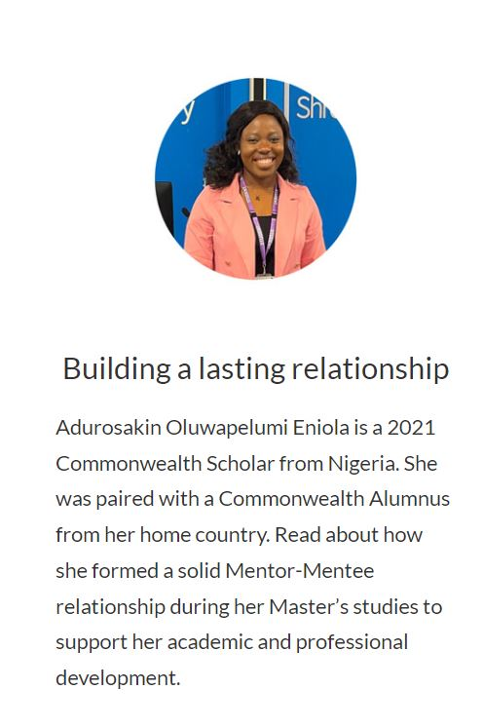
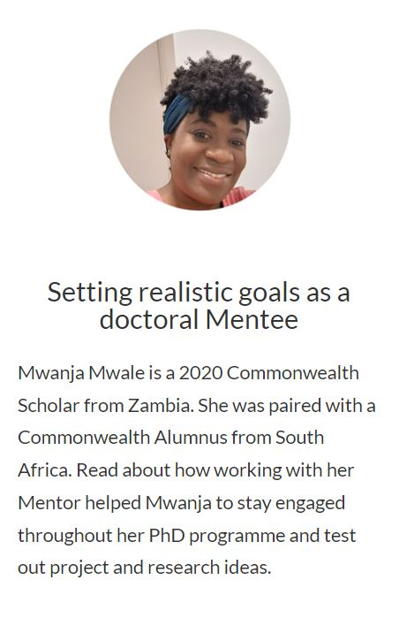
How the programme works
Read testimonials on the CSC website:
cscuk.fcdo.gov.uk/alumni/mentoring-programme/

Slide 12
How to apply
Tips
Applications open: early September
Deadline: Sunday 24 September 2023
Refer to the FAQs on the CSC webpage: cscuk.fcdo.gov.uk/csc-mentoring-programme-frequently-asked-questions-faqs/
Motivation to apply
Outline your skills and expertise
Specify topic areas and keywords relevant to your field of study/work
Do you have a PhD through another route?
Skills you wish to develop
Home-country or Cross-country pairing
Note: no guarantee in pairing
Notes:
TLP activities have included; professional fellowship programme focussed on the specific topic (Girls’ Education; Clean Energy, Air & Oceans, LGBT+ Rights), ACEF funding, internal staff disability confidence training, disability support package, website and application route accessibility audit, appointing additional agencies for specific application routes.

Slide 13
Monika: home-country pairing
Derek: cross-country pairing
Learn from Mentors

Slide 14
Keep in touch
Any questions?
Refer to the FAQs on the CSC webpage:
cscuk.fcdo.gov.uk/csc-mentoring-programme-frequently-asked-questions-faqs/
Email the CSC Alumni Team: alumni@cscuk.org.uk

