Slide 1
CSC Mentoring Programme
Post-scholarship mentoring
18 August 2023

Slide 2
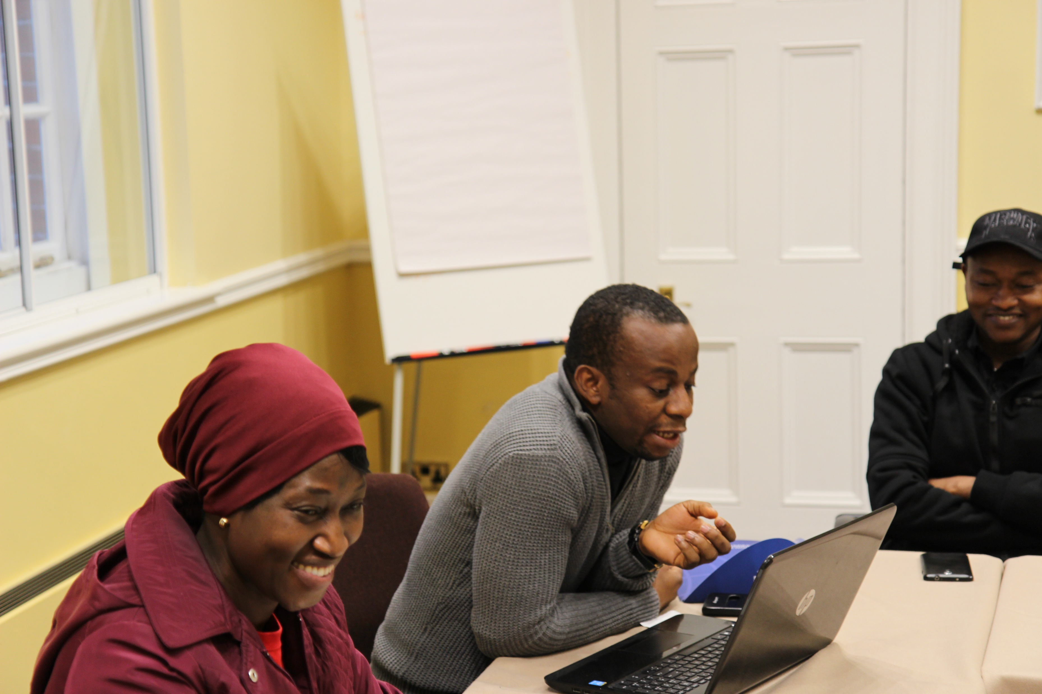
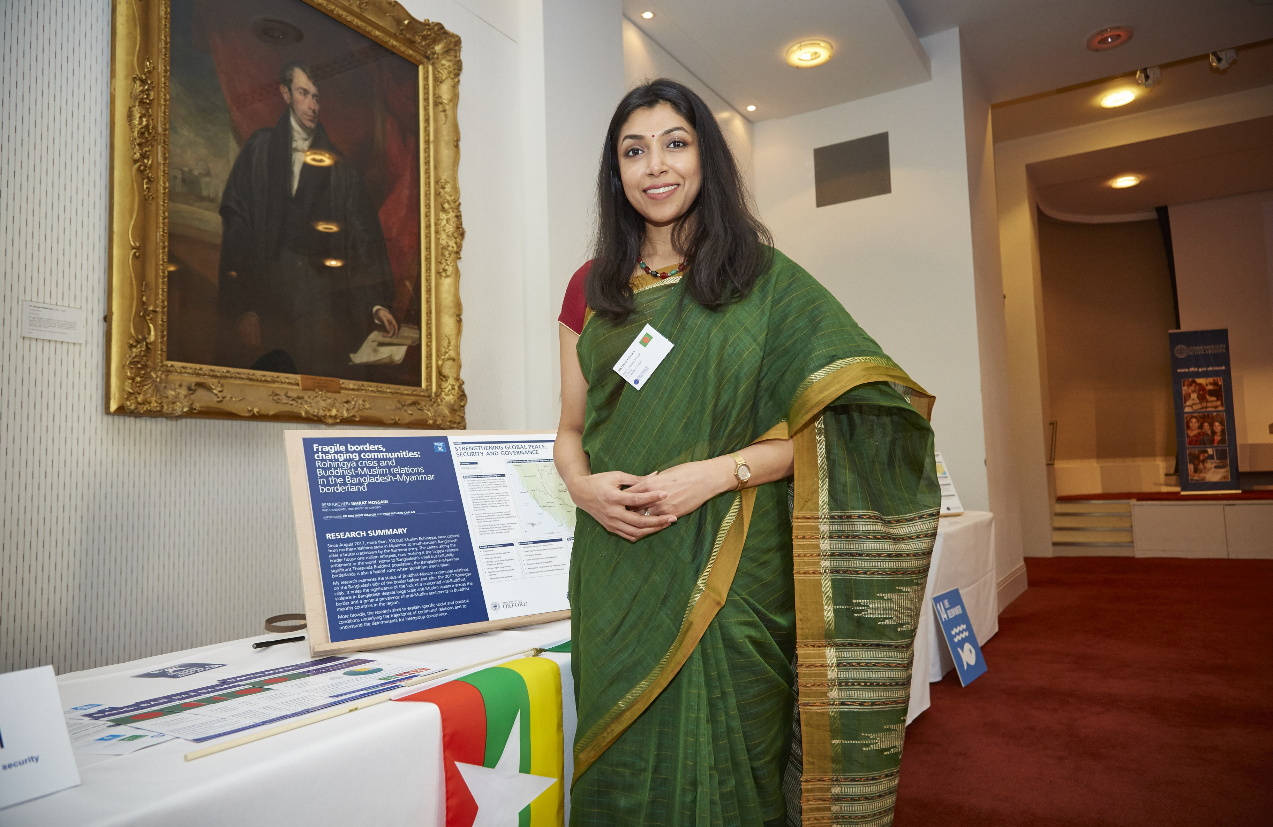
Session overview
What is post-scholarship mentoring?
Role of Mentors
Type of support Mentees may request
Support and resources available
Benefits to Mentors
Evaluation
Q&A
​

Slide 3
What is post-scholarship mentoring?
October-December 2023
Master’s Mentees return home between July-October
Doctoral Mentees continue studies
Understanding the change in the type of support needed during this period
Looking to the end of the formal mentoring cycle

Slide 4
Panel discussion

Slide 5
­Role of Mentors
Your role as a Mentor may change:
Professional development support and guidance
Employability queries
Reflect on goals and learning objectives
More flexible approach to communication
Tap into different skills to support your Mentees
Patience
Listening skills
Two-way problem-solving skills
Career support
Professional skills development
Creating new boundaries:
What you can/cannot support
Availability and frequency of communication:
Time zones may change
New Mentee commitments (work, family)
In-person opportunities for some
Draw on your own experiences
What do you wish someone had told you at this stage?

Slide 6
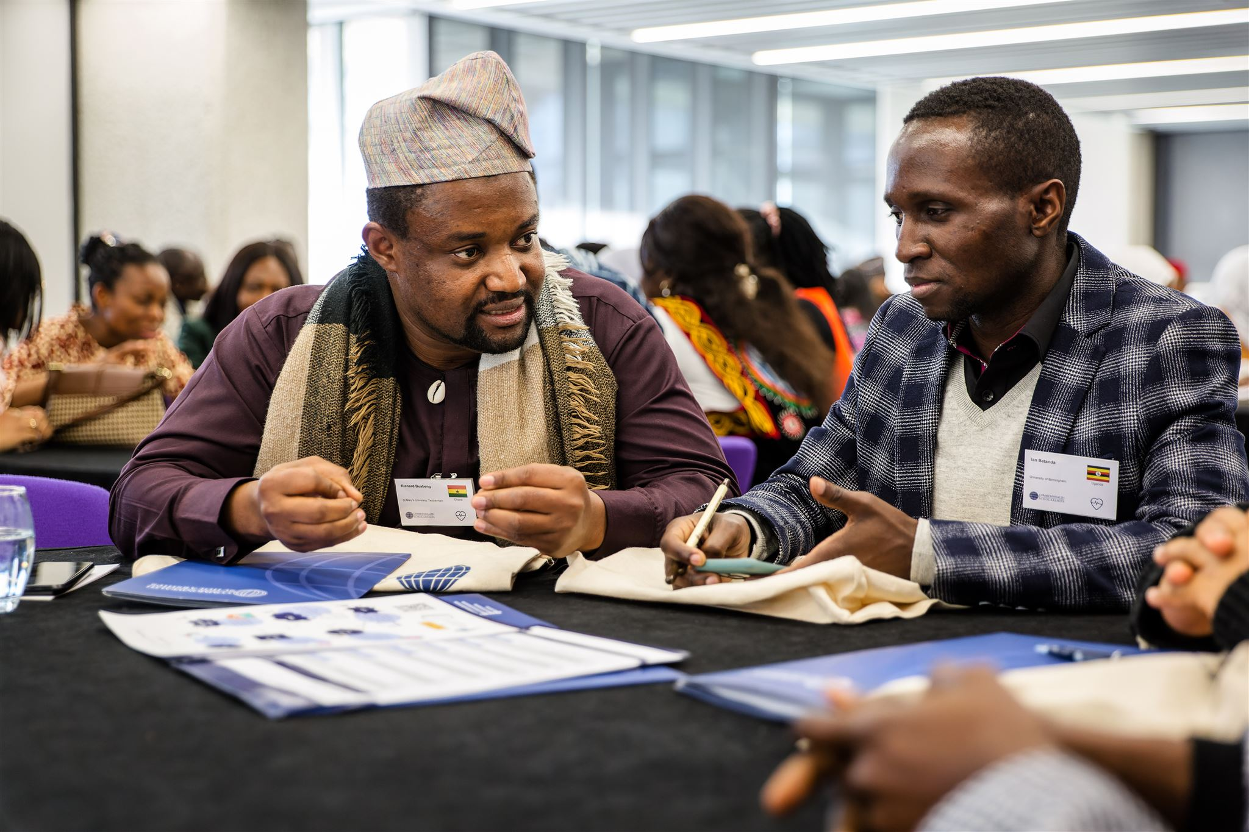
Supporting Master’s Mentees
Key topics for consideration with your Mentee:
Preparing to return home
Reverse culture shock, settling back into routines, wellbeing
Preparing to return to previous employment
Employability skills and advice
Skills and development
Implementing new skills and knowledge
Utilising their networks
Achieving development impact

Slide 7
Employability skills and advice
Career clarity
Skills and professional development
Importance of their network
Developing a personal brand

Slide 8
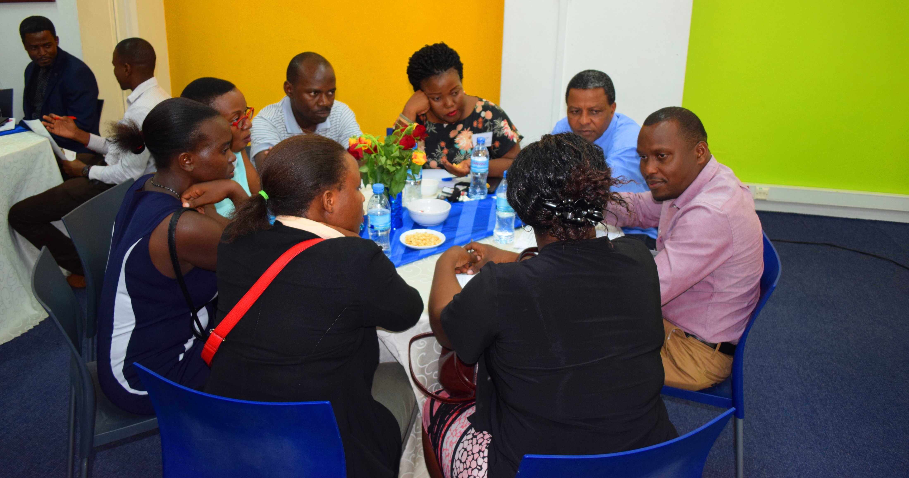
Supporting Doctoral Mentees
Key topics for consideration with your Mentee:
Discuss skills needed to move further in their studies
Building professional and academic networks to support research
Communicating research to a general audience, stakeholders, and potential funders
Implementing skills and knowledge from year 1 into future years of their studies
Professional development skills
Seeking wider research opportunities
Achieving development impact beyond research
Wellbeing

Slide 9
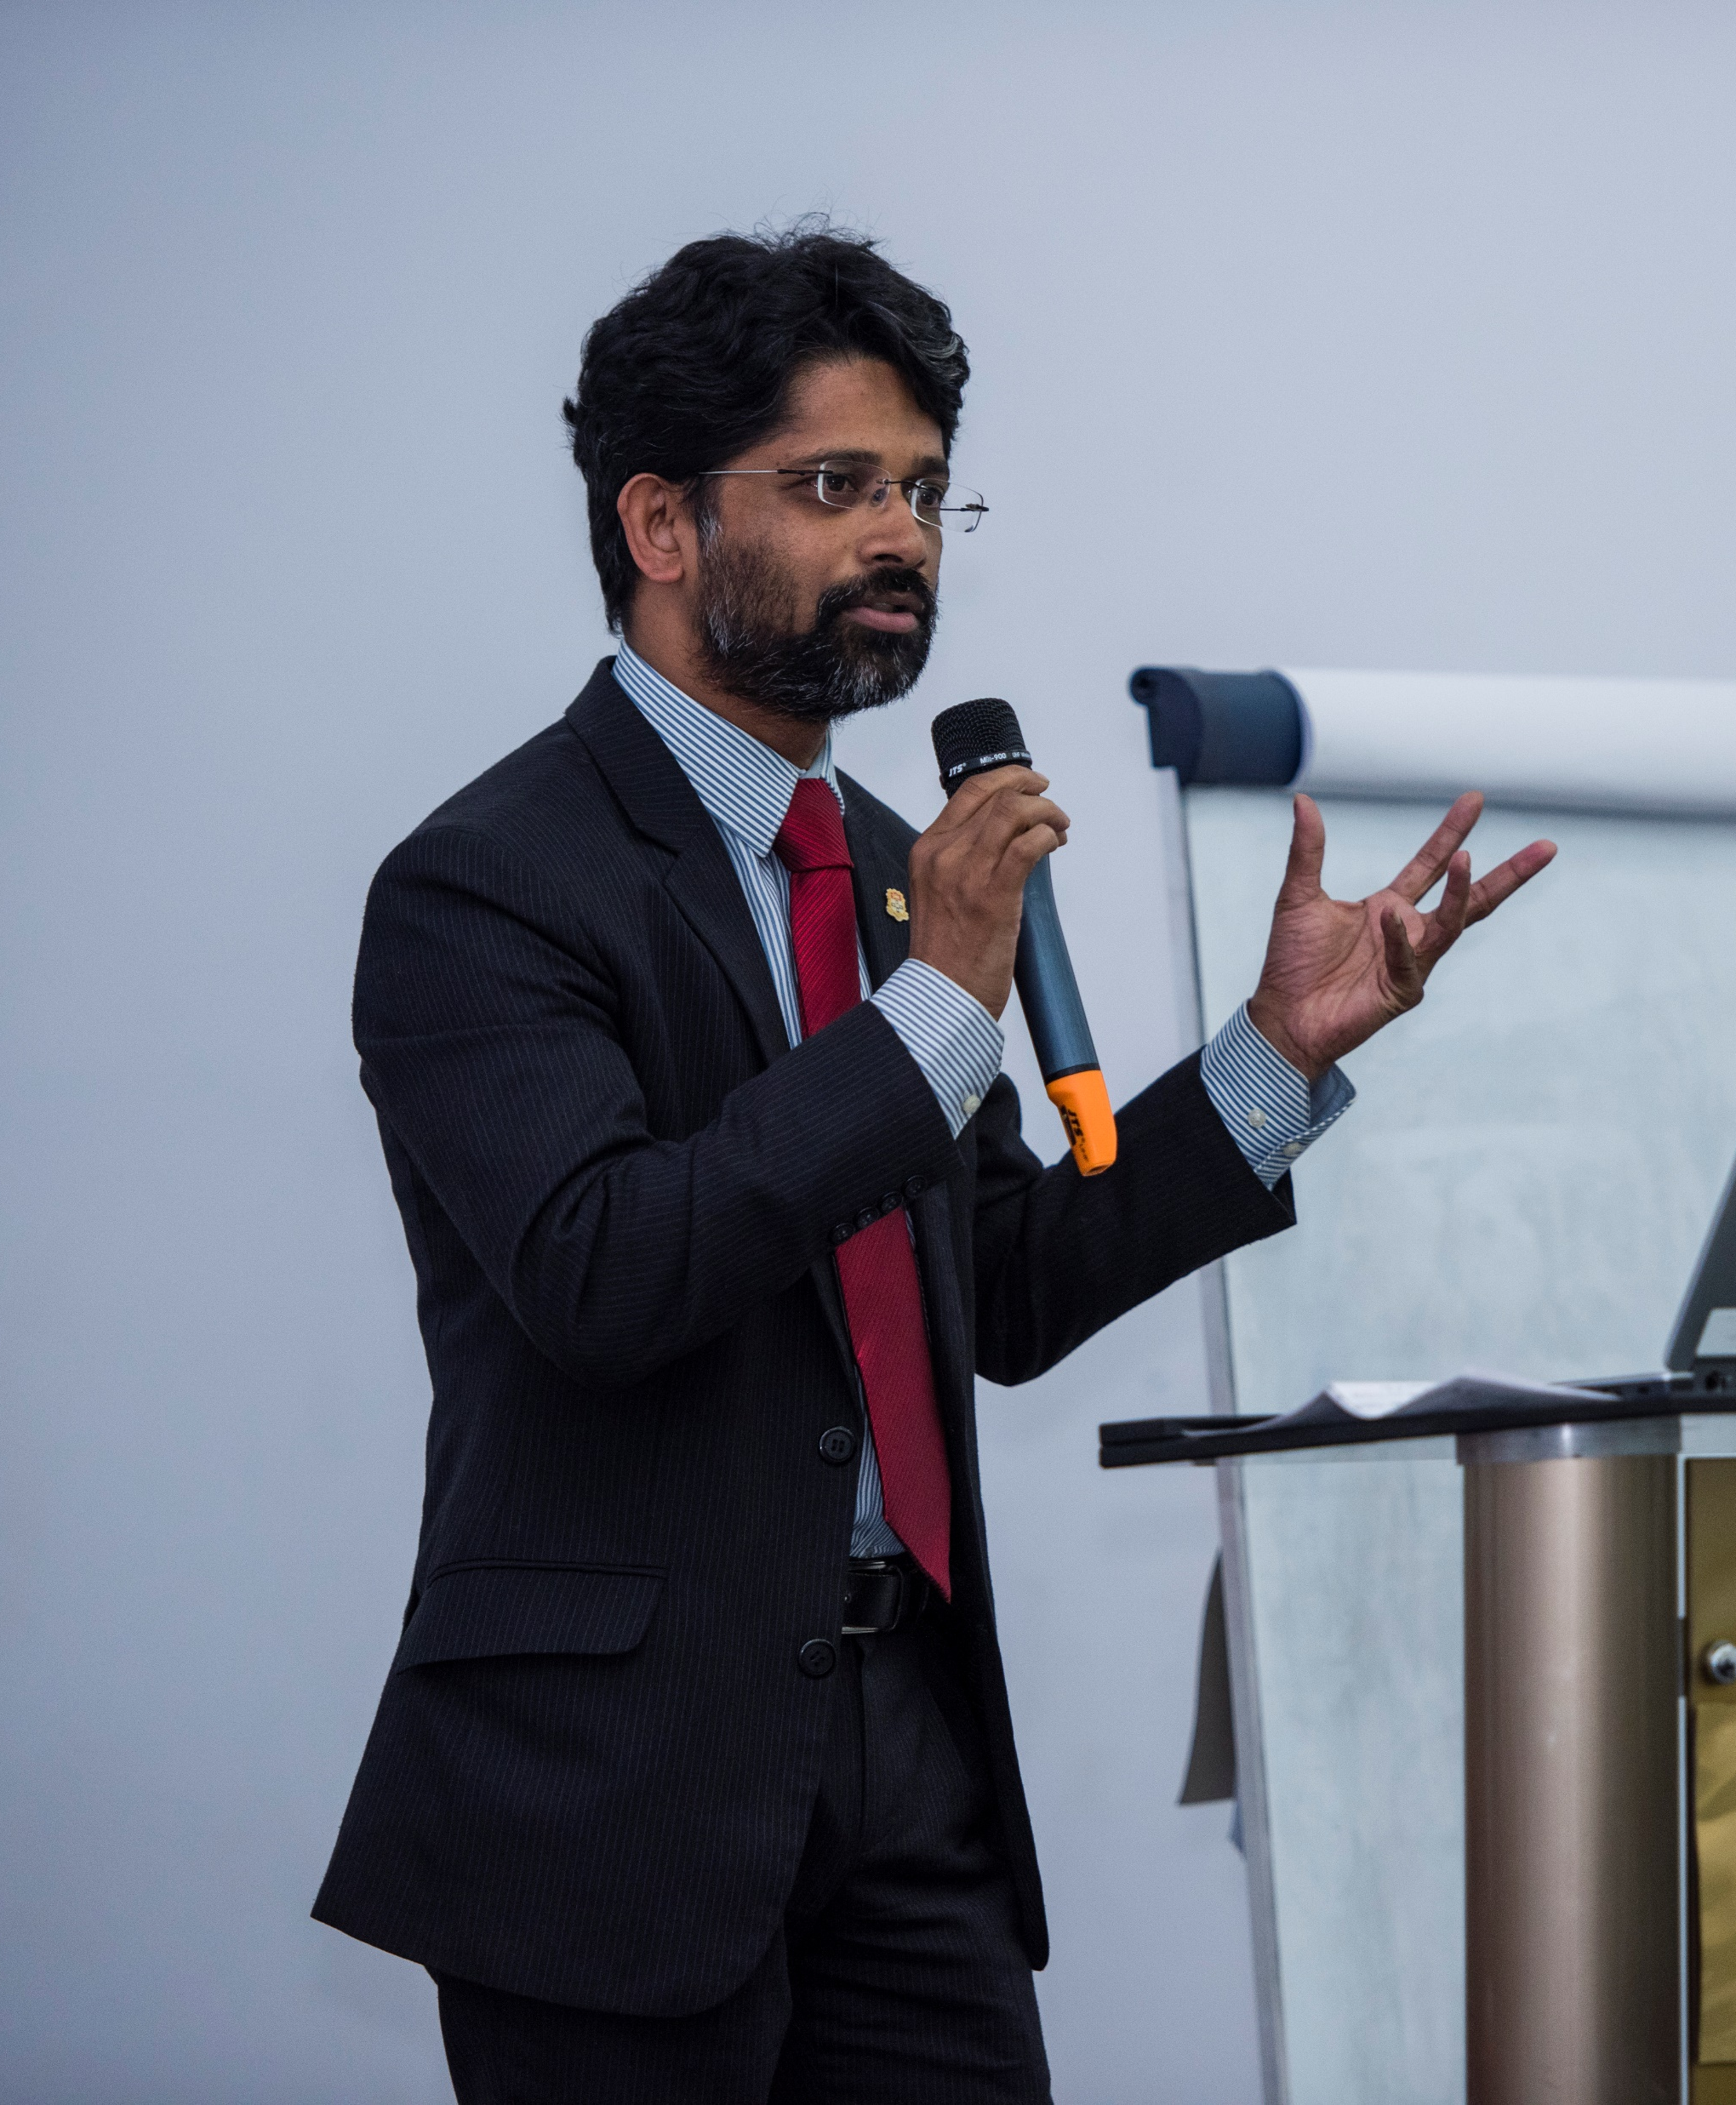
Advancing and communicating research
Communication skills for different audiences
Building a global research network
Research impact beyond academia

Slide 10
Support and resources
Wellbeing resources for continuing Scholars: cscuk.fcdo.gov.uk/student-wellbeing/
Resources for personal and professional development for completing/completed Scholars: cscuk.fcdo.gov.uk/resources-for-personal-and-professional-development-for-alumni/
Handbook resources:
Effective communication
Providing constructive feedback
Making the most of the final weeks
Quick tips sheets to guide topics: cscuk.fcdo.gov.uk/mentoring-programme-resources/
CSC Alumni Network

Slide 11
CSC Alumni Network opportunities
In country events and alumni associations
Development in Action webinar series
Alumni Community Engagement Fund
CSC Research Impact Awards
Publications: Common Knowledge magazine, The Common Room, development impact stories
For more information, visit cscuk.fcdo.gov.uk/alumni/

Slide 12
Taking your mentoring skills further
Understanding challenges facing new alumni and young development professionals and how you can support them
Changing the nature of your mentoring role to career development and supporting high quality research
Utilising your insider knowledge on sectors, desired employer skills, the current job market
Developing new mentoring skills or refine existing skills

Slide 13
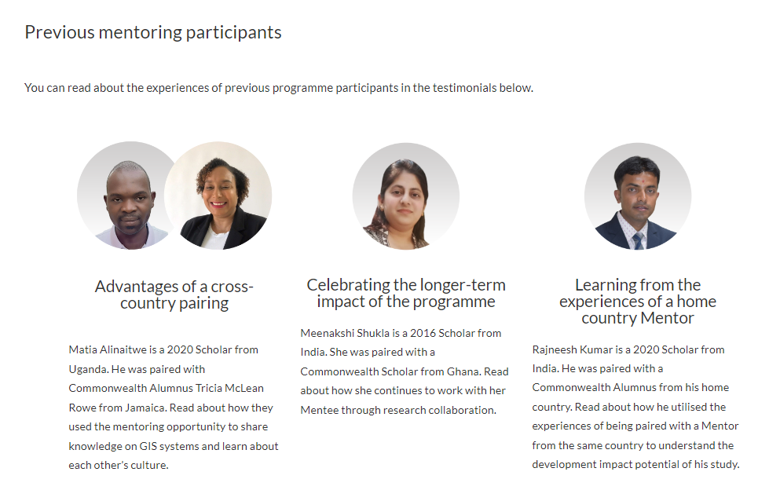
Programme evaluation
Final feedback survey in December and post-4 months survey
Keep us updated on developments
Share your experiences to promote the programme to future participants
Encourage your Mentee to become a Mentor
Evaluation

Slide 14
Contact the CSC Alumni Team at: alumni@cscuk.org.uk
Any questions?
Notes:
TLP activities have included; professional fellowship programme focussed on the specific topic (Girls’ Education; Clean Energy, Air & Oceans, LGBT+ Rights), ACEF funding, internal staff disability confidence training, disability support package, website and application route accessibility audit, appointing additional agencies for specific application routes.

