Slide 1
Housekeeping
Do not take screenshots of the presentation or chat box
Do not use any recording software or equipment during the presentation. This includes the use of Artificial Intelligence (AI) technology
Be respectful to others and behave professionally
Do not use foul or offensive language when communicating with fellow attendees and speakers
Do not share weblinks to join the webinar with others. This is a closed webinar for selected participants only.
Your behaviour should not damage the good name of the CSC
Keep your cameras and mic turned off

Slide 2
2023-2024 CSC Mentoring Programme
Induction webinar

Slide 3
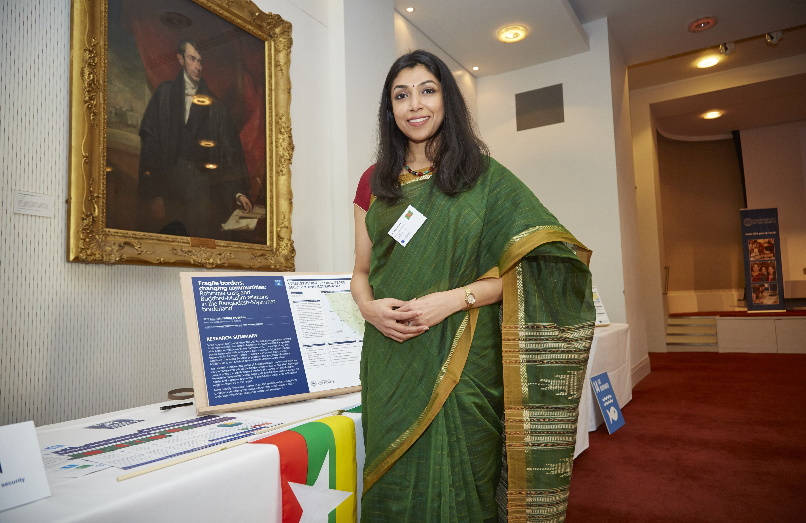
The programme aims to:
Connect Commonwealth Scholars and Alumni
Share knowledge and enhance skills development
Increase understanding of how to achieve development impact post-Scholarship
Provide Scholars with advice and guidance on studying and living in the UK
Develop mentoring and other soft skills
e
​
Introduction
Since 2019, over 650 Commonwealth Scholars and Alumni have participated in the CSC Mentoring Programme

Slide 4
Year-long cycle from December 2023 until December 2024
Achieve SMART goals and longer-term learning objectives
Minimum time commitment is two hours every month
Scheduled touchpoints via mailings
Virtual meet-ups with fellow Mentors and Mentees
Resources
How does the programme work for doctoral Mentees and Mentors?

Slide 5
Mentor: roles and responsibilities
Mentor
Support a doctoral Scholar in developing the appropriate skills and knowledge
Share your skills and expertise in completing doctoral studies
Provide guidance on implementing learning and skills post-Scholarship
Develop your own mentoring and professional skills
Encourage your Mentee to stay connected with the CSC community

Slide 6
Mentee: roles and responsibilities
Seek guidance on how to ensure your doctoral studies will support your development impact goals
Learn more about research dissemination and practical application of research for sustainable development impact
Develop your soft skills for personal and professional growth
Ask questions on how to implement learning and skills after one-year of mentoring support
Seek support in adjusting to living and studying in the UK
Share updates and keep in regular contact
Notes:
TLP activities have included; professional fellowship programme focussed on the specific topic (Girls’ Education; Clean Energy, Air & Oceans, LGBT+ Rights), ACEF funding, internal staff disability confidence training, disability support package, website and application route accessibility audit, appointing additional agencies for specific application routes.

Slide 7
Expectations of Mentors and Mentees
Do not:
Celebrate each other's successes
Two-way learning process
Provide constructive feedback
Adhere to CSC Codes of Conduct
Disclose personal and confidential information
Complete academic work on behalf of Mentee or ask Mentors to complete this
Provide or ask for advice on immigration and welfare matters

Slide 8
5 Stages of the Mentoring Programme
Stage 1
Stage 2
Stage 3
Stage 4
Stage 5
Mid-November - Mid-January
Achieve a short-term goal or learning objective
Review remaining goals
Prioritise remaining time
Rapport building
Mid-January - March
April - June
July - September
October - December
Wrapping up and moving on
Induction webinar
First pulse survey
Second pulse survey
Virtual meet-up
Virtual meet-up
Final feedback survey

Slide 9
Stage 1: induction and introductions
Induction webinar
Mentor and Mentee outcomes
First introductions initiated by Mentor by 20 November
Discuss why you are participating
Mode of communication
Respond to the first pulse survey by 7 December
Mid-November to Mid-January

Slide 10
Stage 2: achieve a short-term goal or learning objective
💡 Refer to page 21 of the Handbook
Mid-January to March
Specific | Be specific about the end results – what do you want to achieve?
Measurable | Should be measurable to help monitor progress and success
Achievable | Within your capabilities but challenging
Relevant | Is it relevant to what you are trying to achieve?
Timebound | Track your progress, identify milestones or delivery dates
SMART goal
Understanding roles
Share response to the second pulse survey in March
Attend a virtual meet-up session

Slide 11
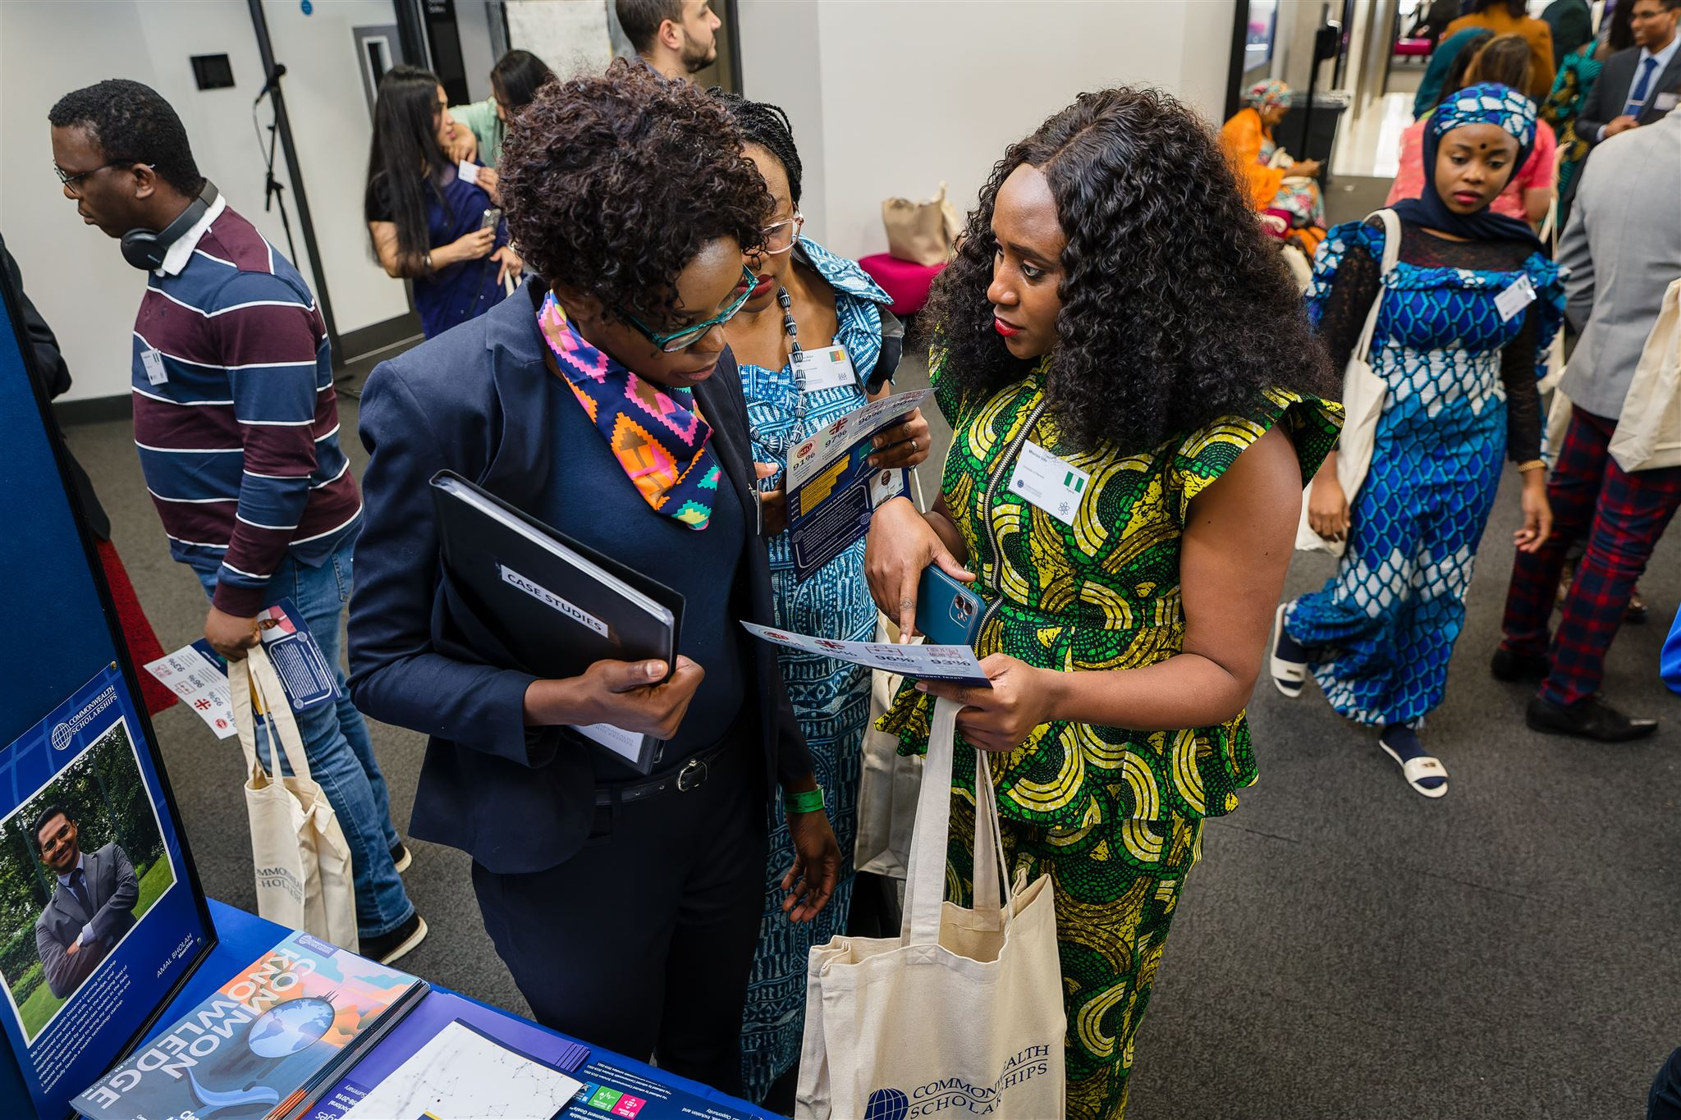
Stage 3: review your goals
Change goals if no longer realistic/applicable
Review roles and actions
Re-set goals
Understanding the support required
Attend a virtual meet-up
April to June

Slide 12
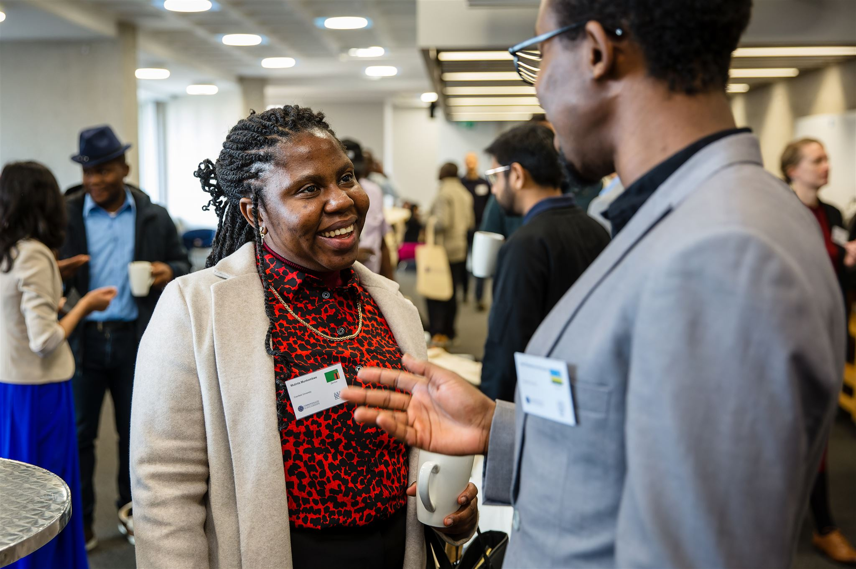
Stage 4: prioritise remaining time
Outline final goals
Prioritise time
Reflect on goals achieved
Virtual meet-up for Mentors on mentoring support during the final stage
June to September

Slide 13
Stage 5: final stage
Discuss how to take your learnings forward
Discuss support needed to develop further research skills
Implementing research to achieve development impact
Reflect on achievements made
Staying in contact
Share responses to the final feedback survey
October to December

Slide 14
The CSC will monitor and evaluate the programme throughout the year
Monitoring and evaluation
First pulse survey | December 2023
Second pulse survey | March 2024
Final evaluation survey | November 2024
Post 4-months survey | April 2025

Slide 15
Resources
CSC website
Handbooks: For Mentees and Mentors
Mentoring log table
SMART goals log
Virtual meet-ups
Handbook
Top tips – page 19
Icebreaker tips – page 20
Setting SMART goals – page 21
Effective communication – page 22
Constructive feedback – page 23

Slide 16
Additional information
Tips
Time zones
Ways of keeping in touch
Finding flexibility
Refer to CSC Policies: page 5
CSC Code of Conduct
Maintaining confidentiality
Duty to report
CSC Safeguarding policy
Wellbeing and support – page 9
Termination of pairings – page 18

Slide 17
Learn from the experiences of previous Mentees and Mentors
Read testimonials on the CSC website:
cscuk.fcdo.gov.uk/alumni/mentoring-programme/
Notes:
TLP activities have included; professional fellowship programme focussed on the specific topic (Girls’ Education; Clean Energy, Air & Oceans, LGBT+ Rights), ACEF funding, internal staff disability confidence training, disability support package, website and application route accessibility audit, appointing additional agencies for specific application routes.

Slide 18
Keep in touch
Any questions?
Refer to the FAQs on the CSC webpage:
cscuk.fcdo.gov.uk/csc-mentoring-programme-frequently-asked-questions-faqs/
Email the CSC Alumni Team: alumni@cscuk.org.uk

