Slide 2
Information session overview
Learn more about the fund
Think about how to approach and deliver your activity
Understand how to assess and mitigate risks
Introduction to the finance process
Key deadlines & Q&A

Slide 3
About the Fund
65 Years of Global Impact: Empowering Commonwealth Change Leaders
​
First fund made available to alumni associations
Developed to ​support alumni associations to celebrate the CSC’s 65th anniversary​
Pilot for future funding opportunities and models

Slide 4
Objectives of the fund
Celebrate the achievements of the CSC and/or Commonwealth Scholars and Alumni in their home country​
Promote the value of CSC in-country networks and relationships to achieving sustainable development​
Broaden and strengthen the CSC’s advocacy base and raise awareness of Commonwealth Scholarships at a national level​

Slide 5
Where are activities taking place?
Bangladesh (BACSAF)- Commonwealth Scholars' Summit: Towards a knowledge Hub​
Canada (CACSF)- 65th Anniversary of the CSC networking event​
Dominica (CDCSAA)- Commonwealth Scholarship In Action​
Ghana (CoSFAG)- Ghana's Human Resource Development: Celebrating the contribution of Commonwealth Scholars and Fellows in Ghana​
Malaysia (CSCAM)- Uniting Expertise, Advancing Action: A CSC Alumni Event for Planetary Health​
Solomon Islands (SICSAA)- Expanding Outreach and Enhancing Visibility of Commonwealth Scholarships Nationally​
Zambia (CAAZ)- 2024 Retreat: 65th CSC Anniversary Celebration ​

Slide 6
Roles and responsibilities of organisers
Roles and responsibilities of CSC
Act as the primary contact for the development and delivery of the activity.
Develop and deliver the activity, working with association members and other contacts as required.
Produce a post-activity report and provide feedback on the funding opportunity.
To meet with you following the information session
Schedule check-ins during your activity organisation
Check and approve expenditure and financial documentation
Check and approve activity risk assessments
Additional assistance:
Sending invitations to alumni
Sourcing alumni speakers
Attendance from a CSC or other representative

Slide 7
Organising your activity- Stage 1
Map your activity
Identify activity risks
Identify your attendees and stakeholders
Identify all fundable items and costs
Assign roles and responsibilities
Resources:
Organiser workplan and budget template
Activity risk assessment (Excel and Word versions available)
cscuk.fcdo.gov.uk/alumni-association-resources/

Slide 8
Assessing risk
Steps to assess risk
You must submit an activity risk assessment for approval before taking your activity forward.
You should build on the information submitted in the application form.
You should also keep a contingency plan prepared in case you are no longer able to deliver your activity as planned.
Step 1- Identify any risks related to your activity
Step 2- Analyse your risks by scoring the likelihood of them happening and the level of potential impact on the activity
Step 3- Assign a target risk score. This should be the level of risk you are willing to undertake.
Step 4- Outline control measures that will mitigate the risk identified
Step 5- Rescore the likelihood and potential impact of the risk identified with the controls in place
Step 6- If your residual risk score is still higher than your target risk score, list additional controls you will need to take

Slide 9
What is safeguarding?
There are many definitions of safeguarding, but in the UK in general terms it means:
‘Protecting peoples' health, wellbeing and human rights, and enabling them to live free from harm, abuse and neglect.’
In your activities, safeguarding should be seen as preventing and responding to harm caused by the abuse of power, position and opportunity.
This includes sexual exploitation, abuse, harassment or bullying by all those involved in the activity development, delivery, and those the activity seeks to support.

Slide 10
Safeguarding means protecting all people, and particularly but not only the most vulnerable in our society, from harm that may arise from contact with your activity.​
It is a duty of care extended to all those involved in the activity.​
This duty of care requires that any partners and contractors acting on your behalf or that you are engaged with also apply a similar safeguarding duty of care and have effective safeguarding systems in place.​
The CSC has a Safeguarding Policy which covers alumni where you are engaged in Commission activity:​
gov.uk/government/publications/csc-safeguarding-policy
If you receive a complaint or legitimate concern relating to a safeguarding issues you should report it immediately. This includes any of the following (though this list is not exhaustive):
Child abuse
Sexual harassment
Racial abuse or harassment
Exploitation, including sexual exploitation
Bullying, including cyberbullying
To report safeguarding concerns in relation to your activity, email csc.safeguarding@cscuk.org.uk
Venues and other organisations involved your activity may also need to report complaints and concerns.
Confidentiality is important but safeguarding must come first. Safeguarding issues must be reported- you can’t promise not to tell anyone once a concern is reported to you.

Slide 11
Organising your activity- Stage 2
Update and share your planning with the CSC Alumni Team
Identify how you will promote your activity
Sense check your activity
Submit financial documents and claim costs
Understand how you will measure success
Resources:
Organiser workplan and budget template
International Bank Transfer form and pay claim forms
cscuk.fcdo.gov.uk/alumni-association-resources/

Slide 12
Organising your activity- Stage 3
Activity delivery
Gather feedback from attendees and fellow organisers
Complete your activity report
Submit feedback to the CSC Alumni Team
Resources:
Activity event report template
CSC feedback survey
cscuk.fcdo.gov.uk/alumni-association-resources/

Slide 13
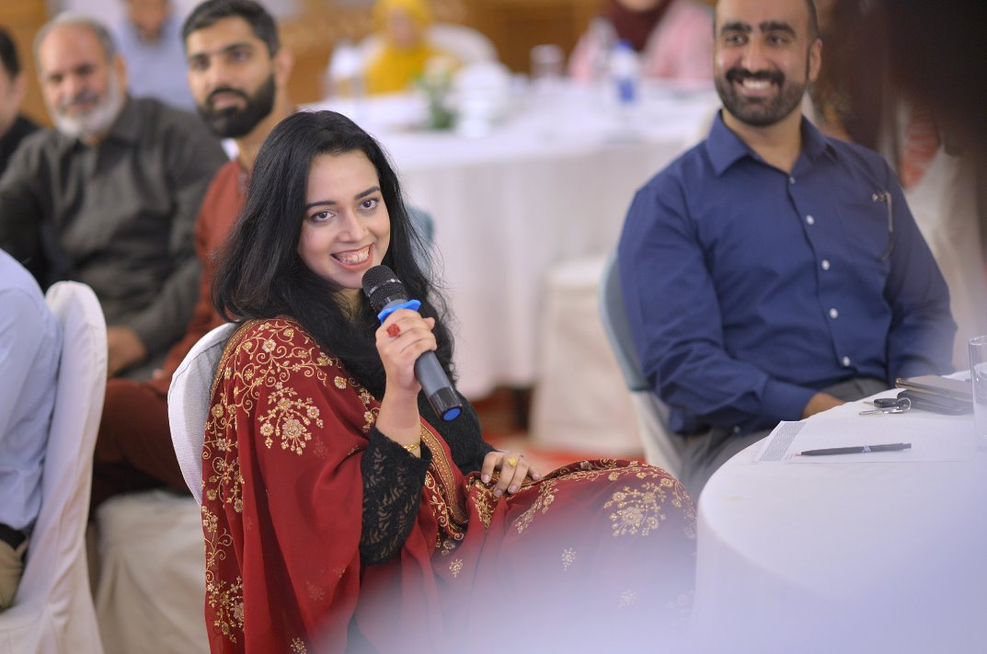
Delivering your activity
Complete due diligence and safeguarding requirements
Share programmes and briefings with attendees and speakers
You should use your association logo to brand your activity and reference the funding support. You cannot use the CSC logo.
Take photographs- always notify attendees
Keep a record of alumni attendees to share with the CSC
Enjoy the opportunity!

Slide 14
Funding- general information
You must use the Organiser workplan and budget spreadsheet to outline all financial costs
All costs and financial documentation (receipts, invoices, quotes) must be approved by the CSC Alumni Team in advance of any vendor agreements and/or payments.
Provide translation if not in English
If you are unable to acquire financial documentation in advance, liaise with the CSC on how to use alternative claim forms:
Financial costs template
Voucher template
Speaker invoice template

Slide 15
Deadlines & payment methods
03 March 2025 deadline- submit all financial costs
Payment information not submitted by 03 March 2025 will not be reimbursed and support will be withdrawn from the planned activity.
Payments will be made by international bank transfer and can take time to be paid. You should consider this when planning your activity- submit at least 6 weeks in advance.
Payments will be made to the alumni association bank account or lead organiser where this is not available.
Some banks may charge for international bank transfers- check and add to budget.

Slide 16
Activity delivery timeline
Dates | Action
August | One-to-one call with CSC Alumni Team
31 December | 70% of activity must be complete
03 March | Payment information deadline
31 March | All activities completed
April | All post-event reports and feedback completed
Ongoing | Publication of event reports and promotion on CSC website and social media channels

Slide 17
Support and resources
cscuk.fcdo.gov.uk/alumni-association-resources/
Terms and Conditions
General guidance
Agreement form
Organiser workplan and budget template
Activity Risk Assessment
Financial documents
alumni@cscuk.org.uk

