Slide 1
Alumni Association Leaders Conference 2025

Slide 2
How the conference works
Two conference sessions
One or more representatives from association leadership
Presented and interactive content
Session #1
Tuesday 18 February 12:00-14:00 GMT
Thursday 27 February 23:00-01:00 GMT
Session #2
Tuesday 04 March 12:00-14:00 GMT
Tuesday 11 March 23:00-01:00 GMT
Must attend both sessions
Different representatives can attend each of the sessions
Full leadership presence across the two sessions where possible
Encourage networking across associations and within leadership structures
Content has been developed by the CSC Secretariat and British Council
Alumni associations invited to present on aspects of their delivery to showcase best practice and peer-learning
Be present and participate in interactive activities to make the most of the opportunity and connect with others

Slide 3
Housekeeping
Be present and engaged
Etiquette
Breaks and leaving early
Use hands-up function to join in live discussion
Use the chat box to share messages and ask questions and connect with fellow attendees
Minimise distractions as far as possible so you can be present during the event
Set yourself a goal to make at least one new connection before leaving the session today
Mute your audio when you are not speaking
You can use your webcam during the sessions however this is not a requirement
Be respectful to those in attendance at all times
Do not use any recording software or equipment, including Artificial Intelligence technology
Maintain confidentiality during discussions and avoid mentioning personal names
There are scheduled breaks however if you need to take additional breaks, please do so
If you need to leave the sessions and rejoin, this is fine
If you need to leave early, please notify us using the chatbox

Slide 4
Objectives of the conference
Bring CSC alumni associations across the Commonwealth together
Celebrate the work of alumni associations and their activities
Provide an opportunity for alumni associations to share best practice and challenges and problem solve together
Share practical and implementable advice and guidance, including updated materials and toolkit
Deliver updates on governance, including CSC policies on safeguarding, EDI and data protection

Slide 5
Agenda- session #2
Alumni Associations: the essentials
Motivating members
Maintaining and growing membership
Successful, engaging, inspiring, valuable, meaningful
Policies
Designing activities

Slide 6
Building your local network

Slide 7
Alumni Associations: the essentials

Slide 8
Primary objectives
Connect Commonwealth Scholars and Alumni in their home country or country of residence
Foster an active and engaged local CSC community
Deliver events and activities showcasing the expertise and contributions of Commonwealth Alumni across a range of sustainable development issues
Promote Commonwealth Scholarships and the power of higher education in achieving sustainable development
Support the work of the CSC in reaching out to the next generation of scholars

Slide 9
Alumni associations: the essentials
A core team- fellow volunteers, leadership structure
Clear vision and objectives- outline a strategy for the association and support this with SMART goals
Constitution or Charter
Association name and logo- branding and visibility

Slide 10
Alumni associations: the essentials (cont.)
Communication- how can members join or contact the alumni association?
Membership eligibility and requirements
National registration- formal or informal association

Slide 11
Motivating members

Slide 12
Key motivators to a joining a membership
Contributing to and feeling immersed in a community
Knowledge exchange
Building personal and professional networks

Slide 13
Key motivators to a joining a membership (cont.)
Developing skills and knowledge not available elsewhere
Prestige
Volunteerism and community engagement

Slide 14
Activity- Addressing membership motivations in association strategies
In breakout groups, select 2-3 membership motivations (you can use those not listed!) and develop 2-3 association ‘offers’ which you feel would address these and attract members.
You should consider:
In what ways the ‘offer’ fulfils the motivation
To what it would be valuable to the member
How you will measure its success
Could you realistically provide all these offers? If not, how will you select which ones to prioritise?
Nominate someone to make notes and report back to the main group.
10 minutes

Slide 15
Maintaining and growing membership

Slide 16
Keeping members engaged
Expectation and anticipation
Variety
Objective and outcome driven
Informative and interesting
Simplicity
Prestige points
Accessibility
If you don’t know- ask!

Slide 17
CSC Alumni Association Leaders Conference
Keeping Alumni Association Members Engaged

Slide 18
Unique Selling Point
The Canadian alumni association caters to both CS alumni (95% who studied in the UK) and QECS who studied in Canada
Alumni are grateful for the opportunity that was given them as students and nostalgic for their positive student experiences but they don’t need much from me to advance their careers
They like reading about their colleagues’ achievements but especially their own achievements
“Thank you for your newsletter. It is always interesting to have news of alumni.”
“Many thanks for your news and support, Kevin, (when I mentioned his new book in a newsletter) and hope all’s well and you’re surviving the harsh pressures coming from Trumpland. Best wishes from Sydney (Australia)”
They are grateful to make useful connections:
“Elizabeth has a new project elizabeth.live and she was hoping to ask you about grants available to Canadian musicians…. [Eve] Happy to help in any way that I can. Elizabeth, please reach out.”

Slide 19
Strategies to engage alumni
LinkedIn and Twitter. Virtually Zero readership but Twitter is a good mechanism to find out what alumni are up to.
Regular Mailchimp newsletter.
2000 valid addresses, 50+% readership
Can easily find 10 news items/month to include
No budget for a tool for more than 2000 addresses.
Unique Events led by alumni
Backstage tour of Royal Opera House
Exhibit tour at Fitzwilliam Museum, Cambridge
Virtual meet and greets
Via Zoom; ran these with up to 30 alumni during COVID

Slide 20
Challenges
Challenges
Getting names and contact information from London
Many, many hours (2000+) doing Google searches to find this information independently
Automatic web crawlers to read news stories with “commonwealth scholar”, etc…
Geography
Canada is large and the biggest concentrations are only 200 alumni
No set budget for travel
I have a reception when I’m travelling on business or pleasure
Convince local alumni to host coffee mornings in small centres
Piggyback on ACU and CSC events in Canada
Sometimes British High Commission and British Council will help

Slide 22
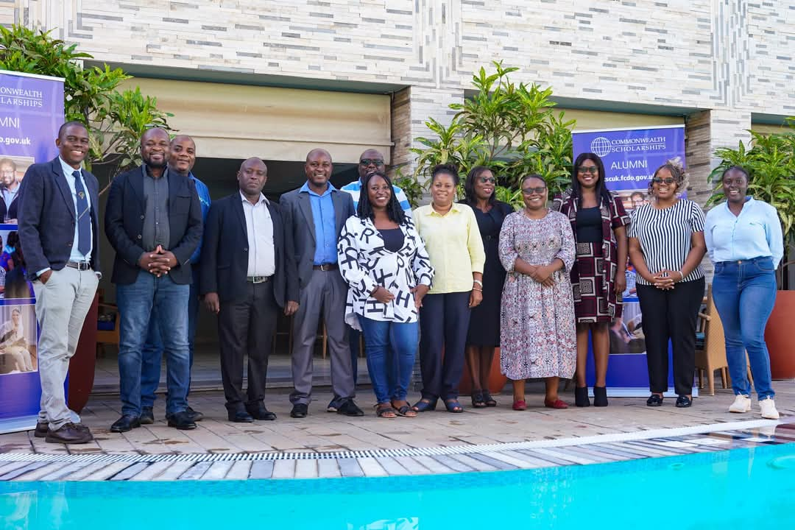
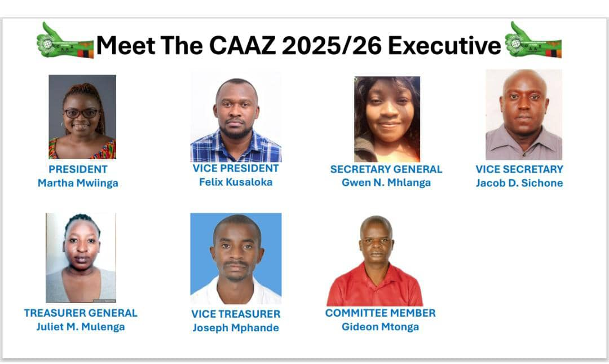
2024 AGM
Strategic Plan
Finances & Membership
Leadership Changes & Continuity

Slide 23
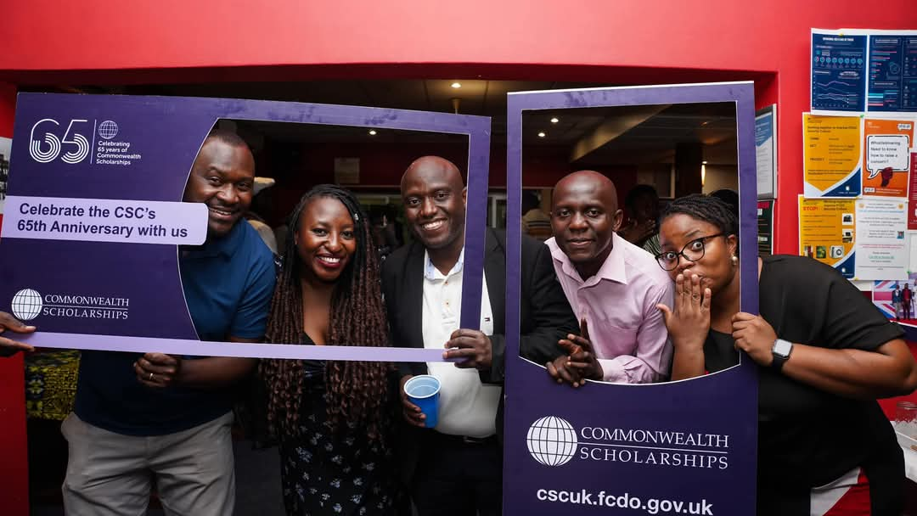
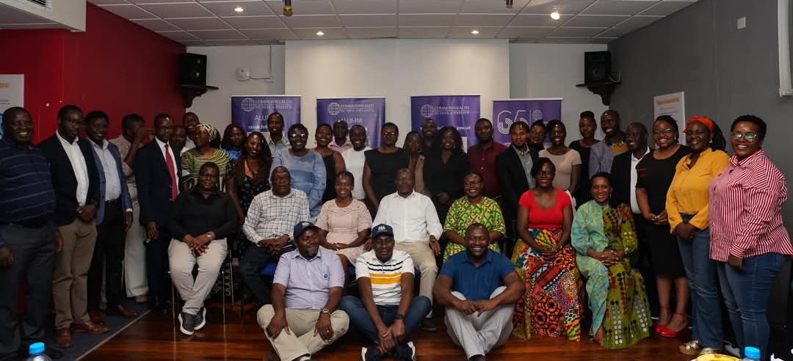

Slide 24
Growing your membership
Different audiences and groups
Needs and wants of these groups
Recruitment methods
Things to consider:
Why do you want to grow your membership?
Who do you want to attract?
Are you ready for new members?

Slide 25
Onboarding members
Welcome messages and information on membership
Outline benefits
What’s coming up- and/or recent round-up
Any open opportunities for new members to get involved in
Policies

Slide 26
Activity- Breaking bad habits
In breakout groups, discuss what bad habits alumni associations may form and how these might impact member engagement.
You should consider:
How bad habits might come about?
What impact do you think these may have on member engagement?
How can you mitigate these bad habits?
If you have adopted any bad habits which may have impacted member engagement, how will address this with your membership?
Nominate someone to make notes and report back to the main group.
10 minutes

Slide 27
Break- 5 minutes

Slide 28
Delivering successful engagement opportunities

Slide 29
Successful, engaging, inspiring, valuable, meaningful

Slide 30
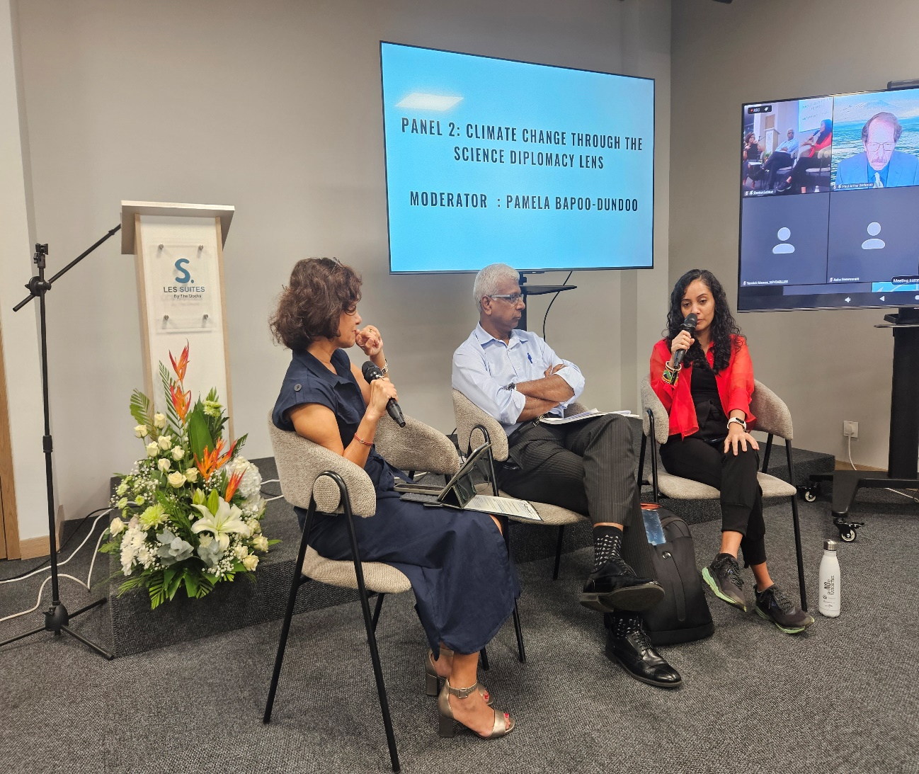
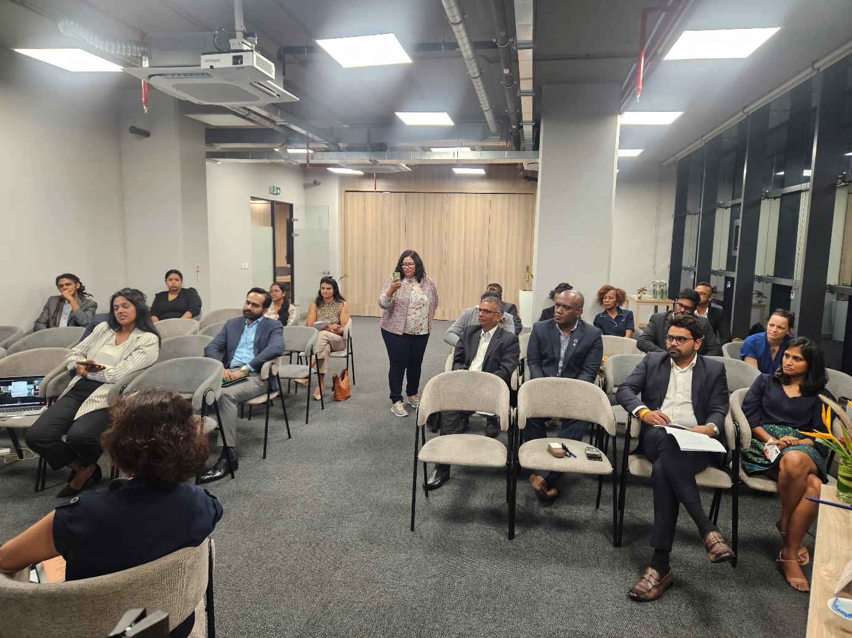
Dr (Ms) V Dookhun (Vice president - UKCAC Mauritius Chapter)
4th March 2025
Report on the Multi-stakeholder ACEF event on the socio-economic impact of climate change in Small Island Developing States.

Slide 31
Designing the event for alumni and stakeholders and lessons learnt
The approach
Engagement of core organizing team
Leadership
Network value
Communication with the sponsor and appreciation of the visions of UKCAC
Meeting with the regulations and risk management protocols
Event dissemination strategies
Media involvement

Slide 32
Ensuring the aims of ACEF and UKCAC are met
Fostering cultural exchanges and development of Commonwealth countries
Define specific, measurable, achievable, relevant, and time-bound (SMART) goals that align with the objectives of both ACEF and UKCAC.
Defining the key stakeholders
Ensuring a comprehensive plan for the event
Collaboration between participants, speakers, and organizations to foster knowledge sharing and networking on the topic
Highlighting success stories

Slide 33
Key metrics of success and the way forward!
Attendance and interest of participants were related to how the event was promoted.
Registration Conversion Rate
Participant Demographics
Background of participant such as age, profession, location, and industry
Event Surveys
feedback from attendees before, during, and after the event to gauge satisfaction
Net Promoter Score (NPS)
likelihood of attendees to recommend the UKCAC event to others
Social Media Engagement
Sponsor Value
sponsor satisfaction.

Slide 34
Types of events and activities
Pre-departure briefing/ farewell event
Welcome home/ completion of studies
Annual General Meeting (AGM)
Meet new scholars
Provide support and guidance
Celebrate successes
Share timely guidance and mentorship
Keep members informed and engaged
Invite feedback and suggestions
Panel discussions and topical lectures
Community engagement
Scholarship promotion
Topics of national interest
SDGs, CSC themes
External community
Internal community

Slide 35
Fail to plan, plan to fail
Essential activity criteria
Activity design- clear and achievable outputs and objectives; meets strategic vision
Viability of the activity- is the activity realistic to its objectives and implementable?
Value for money- keep a budget, shop around
Recruit experts- to support an impactful and effective activity
Risk management- identify risks and control measures
Stakeholder engagement- engaging and managing appropriate stakeholders
Key outputs- short, medium and long term impact

Slide 36
Fail to plan, plan to fail (cont.)
Key considerations
Venue- appropriacy, accessibility
Timeline- to plan and deliver
Sustainability- environmentally friendly services and products, avoid single use items
Virtual engagement- does the event need to be in-person?
Access and inclusion- your activity should be accessible to anyone who wants to attend
Safeguarding- proactively safeguard and promote the welfare of all those associated with your activity
Promotion- advance notice, reminders, utilise channels- create excitement!
Keeping a record- attendees, speakers, logistical and vendor details
Photography/videography- clear and informed consent, defined purpose and outputs

Slide 37
Policies

Slide 38
Safeguarding
Assessing risk
There are many definitions of safeguarding, but in the UK in general it means:
‘Protecting peoples’ health, wellbeing and human rights, and enabling them to live free from harm, abuse and neglect.’
In your activities, safeguarding should be seen as preventing and responding to harm caused by the abuse of power, position and opportunity.
This includes sexual exploitation, abuse, harassment or bullying by all those involved in the activity development, delivery and those the activity seeks to support.
Risk assessments enable us to plan for and mitigate risks
Likelihood of a risk vs the impact of a risk should it occur
Building in control measures to mitigate and reduce risks
Work with activity stakeholders- venue, providers, speakers, audience groups (e.g. schools, communities)
Always keep a contingency plan

Slide 39
Activity- Planning a successful, engaging, inspiring, valuable, meaningful activity
In breakout groups, design an activity for alumni using the information shared in previous slides and experiences of fellow group members.
You should discuss and agree:
2-3 key objectives for the activity
Strategic vision or objectives the activity will support
Activity brief- title, summary of the activity, audience
2-3 outcomes of delivering and participating in the activity
Stakeholders to engage
Key risks for consideration
Nominate someone to make notes and report back to the main group. We will ask groups to screen share their notes (where possible).
20 minutes

Slide 40
Questions and final reflections

