Slide 1
Alumni Community Engagement Fund (ACEF) information session

Slide 2
Information session overview
Learn more about ACEF and this year’s winners
Think about how to plan and deliver your activity
Consider ways of measuring impact and scaling up
Understand the funding process
Note key deadlines and contacts

Slide 3


About ACEF
The objectives of ACEF are to:
Support Commonwealth Alumni in promoting and raising awareness of key development issues at the local community level
Demonstrate ways in which Commonwealth Alumni create positive change within their communities
Promote opportunities for Commonwealth Alumni to work together and build connections and networks
The fund was introduced in 2019 and supported activities across a range of themes and delivery areas.
The overall aim of ACEF is to champion
Small Changes for Big Impact.

Slide 4

2025 ACEF themes
Three funding themes are being supported:
Building an entrepreneurial ecosystem:
7 activities
Together We Thrive – a Commonwealth for the next generation:
5 activities
Towards zero hunger:
3 activities

Slide 5
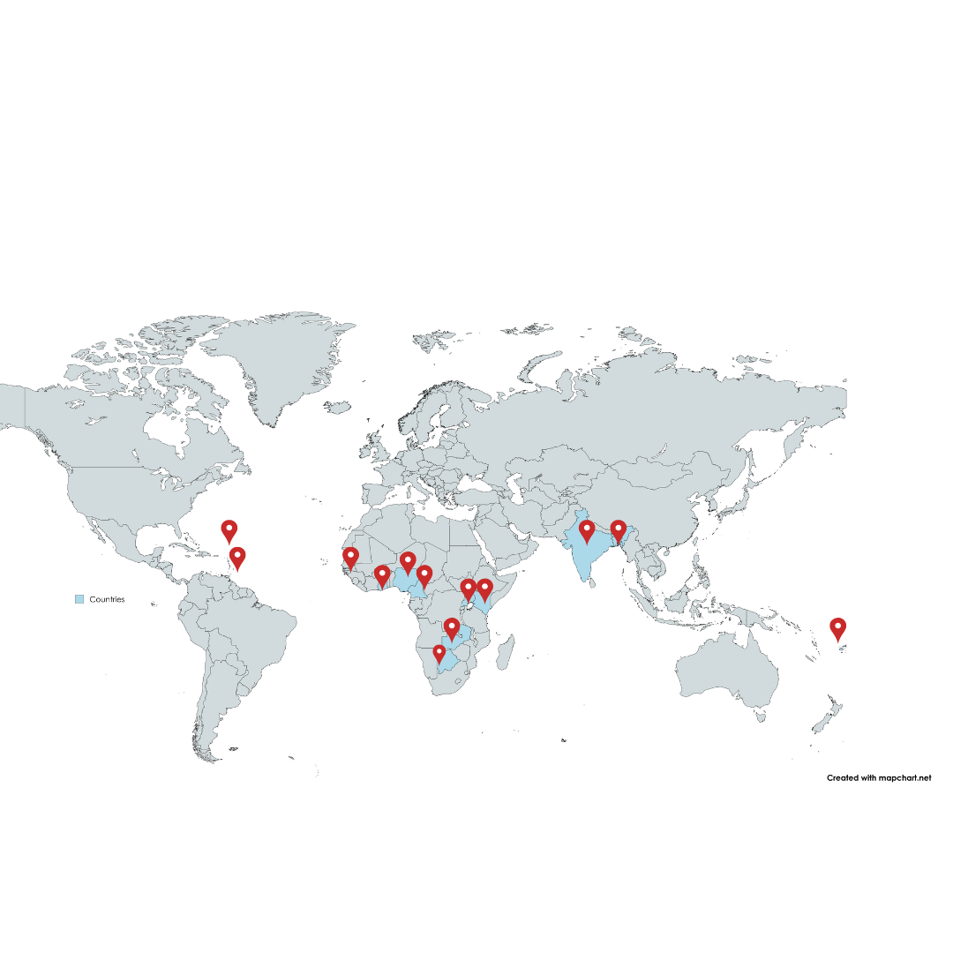
Countries represented
Countries | Activities
Antigua and Barbuda | 1
Bangladesh | 1
Botswana | 1
Cameroon | 1
Fiji | 1
Ghana | 1
Grenada | 1
India | 1
Kenya | 2
Nigeria | 1
The Gambia | 1
Uganda | 2
Zambia | 1

Slide 6
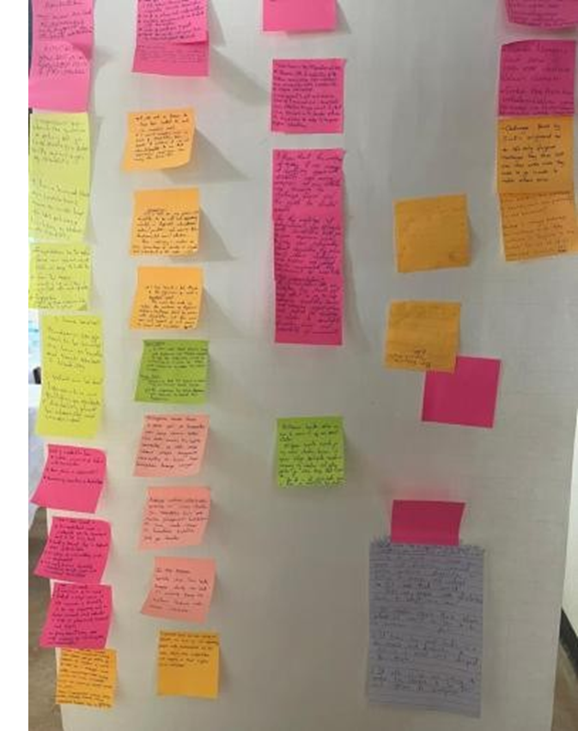
Roles and responsibilities
Act as the primary contact for the development and delivery of the activity.
  Attend meetings and provide updates with your ACEF contact
  Key liaison with stakeholders and fellow organisers
Develop and deliver the activity, working with others where required.
  Develop the activity and think about activity budget
  Submit the activity risk assessment
Provide a post-activity report and feedback.
  Share feedback on the ACEF process
  Submit an activity report
As organisers

Slide 7
Roles and responsibilities
To meet with you following the information session
Schedule check-ins (1-2) during your activity organisation
Check and approve expenditure and financial documentation
Check and approve the activity risk assessment and activity programme
Remember- this is your activity. Your ACEF contact will not organise, liaise with vendors, attendees or stakeholders on your behalf.
If you have any questions about organising your activity, you should email your ACEF contact for support at alumni@cscuk.org.uk
As ACEF contact

Slide 8
Stage 1: Organising your activity
Map your activity
Identify all fundable items
Complete the activity risk assessment
  Use the workplan template
  Identify key actions and the order these need to be achieved
  Assign deadlines to complete each action
  Working with others? Assign responsibility
  Complete due diligence and safeguarding requirements
  Refer to the activity and budget planning guidance
  Obtain quotes from vendors for approval: 3 vendors to price compare
  Gain approval from your ACEF contact before committing any funds
Return your completed activity risk assessment to your ACEF contact for approval before taking your activity forward​

Slide 9
Assessing risks

Slide 10
Activity risk assessment
Step 1- Identify any risks related to your activity. Pre-populated risks but you should add further risks identified and relevant to your activity.
Step 2- Analyse your risks by scoring the likelihood of them happening and the level of their potential impact on the activity
Step 3- Assign a target risk score. This should be the level of risk you are willing to undertake.
Step 4- The 'Control measures’ - modify
Step 5- Rescore the likelihood and potential impact of the risk identified with the controls in place.
Step 6- If your residual risk score is still higher than your target risk score, list the additional controls
You must submit an ‘Activity risk assessment’ to your ACEF contact for approval before committing to any funding or taking forward your event.
Tips to successfully assess risks:
You should build on the information submitted in your application form
Modify the control measures as per your activity
Take into consideration local laws and other requirements to deliver your activity including legal principles such as Free, Prior and Informed Consent (FPIC) which ensures Indigenous Peoples have the right to give or withhold consent to activities which may affect their lands, territories and resources

Slide 11
Assessing risk
You should keep a contingency plan prepared in case you are no longer able to deliver your event in-person. This may mean changing the date of your event, number of people attending, and moving to an online event, for example.
Example: If you are delivering a face-to-face activity, you must stay up to date with COVID-19 rules and situational changes. You should keep your ACEF contact informed of any COVID-19 updates and take their advice on changes you may need to make to your activity.
Refer to the Activity and budget planning guidance document for more information.
Contingency planning

Slide 12
Safeguarding
Effective safeguarding systems and duty of care to be applied by any partners and contractors acting on your behalf or that you are engaged with.
If you receive a complaint or a legitimate concern relating to a safeguarding issue should report it immediately. This includes any of the following examples (though is not an exhaustive list):
  Child abuse
  Sexual harassment
  Racial abuse or harassment
  Exploitation, including sexual exploitation
  Bullying, including cyberbullying
To report safeguarding concerns in relation to your ACEF activity, email - csc.safeguarding@cscuk.org.uk
Confidentiality important but safeguarding must come first. Safeguarding issues must be reported – you can’t promise not to tell anyone once a concern is reported to you.
What is safeguarding?
There are many definitions of safeguarding, but in the UK in general terms it means:
'Protecting peoples' health, wellbeing and human rights, and enabling them to live free from harm, abuse and neglect.'
In your activities, safeguarding should be seen as preventing and responding to harm caused by the abuse of power, position and opportunity.
This includes sexual exploitation, abuse, harassment or bullying by all those involved in the activity development, delivery, and those the activity seeks to support.
The CSC has a Safeguarding Policy which covers alumni where you are engaged in Commission activity:
  https://www.gov.uk/government/publications/csc-safeguarding-policy

Slide 13
Stage 2: Planning your activity
Update and share your planning with your ACEF contact regularly
Identify promotional routes and contacts
Sense check your activity
Ask for their insight and advice at the early stages of your planning
Confirm dates and deadlines
Share your activity programme itinerary
Think about the best ways to reach the community
Liaise with key contacts where required
Speakers, stakeholders
Does this meet the needs of the community? Will it be delivered on time?
Does your activity clearly address the ACEF theme?
Access and inclusion

Slide 14
Stage 3: Ways to measure impact and scaling up
Measure success
Scalability
Keep CSC posted about short-and long-term impact
How will you gather feedback and information on the success of the activity from your community?
  Tips and guidance on the next slide
Think about ‘Small Changes for Big Impact’
How could you and/or others upscale your activity in future?
Submit your event report and key insights from the feedback gathered
Complete the ACEF feedback survey
Complete post 4-months feedback survey

Slide 15

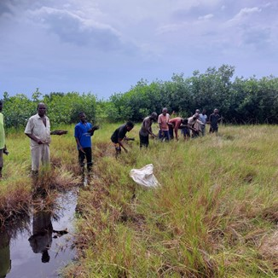
Measuring success
Feedback questionnaires or surveys
Informal feedback: show of hands, verbal
Activity type | Indicators
Skills development | Pre- and post-knowledge Planned skills application Dissemination of skills or information Next steps Measured increase in knowledge Stakeholder engagement Ideas and knowledge sharing Networking and increased contacts
Awareness raising
Public service
Discussion/ debate
Post-activity follow-up: site-visits, communication

Slide 16
Funding

Slide 17
General information
Use ACEF Organiser Workplan and Budget spreadsheet
Approve all costs
Alternative claim forms
All costs and financial documentation (e.g. receipts, invoices, quotes) must be approved by your ACEF contact in advance of any agreements with vendors or payments made
English translation of receipts
If you are unable to acquire financial documentation in advance, liaise with your ACEF Contact on how to use alternative claim forms
Outline all financial costs associated with your activity
Refer to the funding guidance outlined in ACEF Terms & Conditions

Slide 18
Types of claim forms
Financial cost template
Voucher template
Speakers invoice template
Use this template where financial evidence cannot be gathered in the form of quotes or invoices.
You must provide some form of alternative evidence of costs alongside this claim, such as links of costs stated on websites or written confirmation from vendor(s) on formal letterhead.
Use this template to provide details of reimbursement costs for expenses incurred by participants to attend the ACEF activity (Eg: Travel to the venue using public transport)
Agree a fixed cost to be reimbursed for the expense(s) with the participants and CSC in advance of the activity delivery date
Use this template to provide details of speakers, facilitators and/or volunteer(s) receiving honorarium costs

Slide 19
Receipt of funds and goods
Report additional cost(s)
Submit evidence of receipt of goods
Remittance guidance
Any additional cost(s) incurred during the activity which were not approved in advance should be reported to your ACEF contact immediately along with evidence of the additional cost(s)
Submit evidence of receipt of goods funded by ACEF.
This can be in the form of delivery notes and photographs of the items.
Eg: receipt of payment from caterers, photographs of stationery such as banners, promotional materials
If you have received payment higher than the total required to deliver your activity, you must inform your ACEF contact and propose alternative ways in which this funding can be used.

Slide 20
Deadlines and payment methods
Deadline to submit financial costs
Payment methods
Deadline to deliver activity
3 March 2026: Submit all financial costs.
Notify your ACEF contact if your activity will not be delivered or if you will not use the funding by this deadline.
Payment information not submitted by this deadline will not be reimbursed and support will be withdrawn from the planned activity
International bank transfers
Submit payment requests at least six weeks in advance
Note: some banks may charge for international bank transfers
Complete and submit the correct payment forms – international bank account or UK bank account
31 March 2026: deadline to deliver your activity
31 December 2025: your activity should either be approved for delivery or at least 70% complete. If the CSC is not satisfied with the progress of the activity, the fund may be withdrawn.

Slide 21
Activity promotions

Slide 22
How will you promote your activity?
Timeline
Inviting external speakers and/or guests
Keep a record of participant numbers
Factor in time to promote activity
Identify relevant and appropriate channels
Approach them early in planning process
Monitor the number of participants
Tip: Refer to the ACEF activity and budget planning document
Photography and videography
Welcome and introductions
Using the CSC logo
Notify all participants
Note: CSC cannot use images of children under 18 year of age
Say a few words about yourself and CSC-funded ACEF
Cannot use CSC logo
Use text to acknowledge the funding

Slide 23

Activity timeline
Dates | Action
18-29 August | One-to-one calls with CSC ACEF contact
31 December | 70% of activity must be complete
Note: December | UK holidays – limited support for your activity. Get in touch until first week of December.
3 March | Payment information deadline
31 March | All activities completed
Early April | Post-event report and ACEF activity feedback survey
August | Post-4 month feedback survey

Slide 24
Support and resources
Check the ACEF resources webpage: https://cscuk.fcdo.gov.uk/alumni-community-engagement-fund-resources/
Terms and Conditions
Activity workplan and budget guidance
Organiser workplan and budget template
Activity risk assessment
Email CSC ACEF contact: alumni@cscuk.org.uk

Slide 25
Q&A

