Slide 1
2026 Commonwealth Scholarships

Slide 2
About me
Name
Year of Scholarship/Fellowship
Commonwealth [Split-site/Shared/Distance Learning] Scholar/Fellow from [Country]
[Degree] [Subject]
[UK University]
Notes:
For Commonwealth Alumni / CSC Alumni Association use only- please update this slide with information about your Commonwealth Scholarship/Fellowship. If you are presenting on behalf of your Alumni Association, you may wish to add your relationship to the association, for example ‘Chairperson, Malawi Commonwealth Alumni Association Network (MCAAN).

Slide 3
Introduction to Commonwealth Scholarships

Slide 4

Background
The Commonwealth Scholarship Commission (CSC) was founded in 1959
The UK’s contribution to the Commonwealth Scholarship and Fellowship Plan (CSFP)
Commonwealth Scholarships are funded by the UK Foreign, Commonwealth and Development Office
The CSC offers 7 programmes of study
Over 31,000 individuals have been awarded a Commonwealth Scholarship or Fellowship
Notes:
The Commonwealth Scholarship Commission was founded in 1959 to deliver the UK’s scholarship contribution to the Commonwealth Scholarship and Fellowship Plan (CSFP)
The CSFP is an international programme that provides scholarships and fellowships for citizens of Commonwealth countries to study in other Commonwealth member nations
Commonwealth Scholarships to study in the UK or with a UK institution are funded by the Foreign, Commonwealth and Development Office of the UK government

Slide 5
About Commonwealth Scholarships
Support the co-creation of research, innovation and solutions to advance sustainable development priorities
Work with nominating agencies to select candidates whose studies will address the skills, knowledge and sustainable development needs of their country
Support candidates from underrepresented backgrounds to access lifechanging higher education opportunities

Slide 6







Contributing to sustainable development
Commonwealth Scholarships and Fellowships foster a community of future leaders with the knowledge and expertise to drive sustainable development and address pressing global issues in their home countries and beyond.
Commonwealth Scholarships contribute to the United Nations Sustainable Development Goals and are awarded under 6 CSC Development themes.
Science and technology for development
Improving population health, health systems and capacity
Promoting innovation and entrepreneurship
Strengthening global peace, security and governance
Strengthening resilience and response to crises
Access, inclusion and opportunity

Slide 7

What do Commonwealth Scholarships offer?
Fully funded study at a UK institution
Visa and travel costs for awardees travelling to the UK
Additional financial support, including family allowance and disability support
Opportunities to meet scholars and alumni and build meaningful networks
Access to further professional development training
Engagement in a global alumni network

Slide 8
Applying for a Commonwealth Scholarship

Slide 9
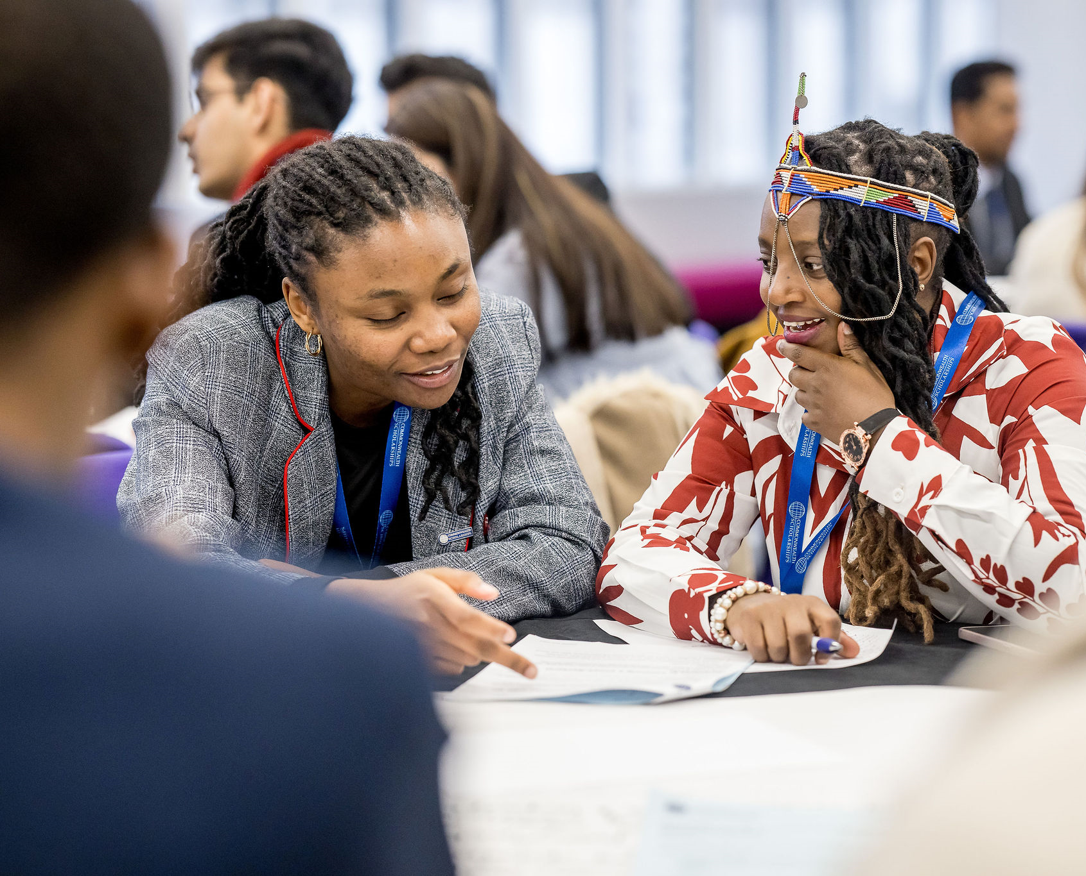
Country eligibility: Lesotho
Commonwealth Master’s Scholarship
Commonwealth Shared Master’s Scholarship
Commonwealth Distance Learning Master’s Scholarship
Commonwealth PhD Scholarship
Commonwealth Split-site PhD Scholarship
Commonwealth Professional Fellowship
Commonwealth Startup Fellowship

Slide 10
Commonwealth Master’s Scholarships
Nominators
Support students to undertake a full-time taught Master’s degree at a university in the UK.
Application timeline:
Applications open: 02 September
Applications close: 14 October
For more information visit cscuk.fcdo.gov.uk/scholarships/commonwealth-masters-scholarships/
Candidates must apply through a nominating agency and the CSC.
Each nominating agency has its own selection process and may have additional eligibility criteria.
Applicants must check with their chosen nominating agency for specific guidance.
Nominating agencies may set their own closing date for applications.

Slide 11
Commonwealth PhD Scholarships
Nominators
Support students to complete full-time doctoral studies at a UK university.
Commonwealth PhD Scholarships are for graduates undertaking world-class research with a clear sustainable development application.
Application timeline:
Applications open: 02 September
Applications close: 14 October
For more information visit cscuk.fcdo.gov.uk/scholarships/commonwealth-phd-scholarships-for-least-developed-countries-and-vulnerable-states/
Candidates must apply through a nominating agency and the CSC.
Each nominating agency has its own selection process and may have additional eligibility criteria.
Applicants must check with their chosen nominating agency for specific guidance.
Nominating agencies may set their own closing date for applications.

Slide 12
CSC Nominators
National nominating agencies are government ministries of education, skills or human resource development who act on behalf of their national government.
  They shortlist candidates with proposed study plan that sit with their government’s sustainable development priorities.
Non-Governmental Organisation (NGO) and charity nominators work on high priority issues in sustainable development, including gender equity, disability rights, LGBT+ rights, and refugees.
  They further the CSC’s mission to provide scholarship opportunities for all, regardless of background or disadvantage.
Applicants can apply through a national nominating agency or NGO or charity nominating agency.

Slide 13


Nominators for Lesotho
National nominating agency
National Manpower Development Secretariat
nmds.awards@gmail.com
Commonwealth Disabled People’s Forum (CDPF)
commonwealthdpf.org
The Commonwealth Equality Network (TCEN)
commonwealthequality.org/

Slide 14


Nominators for Lesotho
Canon Collins Educational and Legal Assistance Trust
canoncollins.org/
HALI Access Network
haliaccess.org/

Slide 15
Commonwealth Shared Scholarships
Support students to undertake an approved full-time taught Master’s degree at a participating university in the UK.
They are delivered in partnership with UK universities who provide co-funding and administrative support.
Application timeline: TBC
For more information visit cscuk.fcdo.gov.uk/scholarships/commonwealth-shared-scholarships-applications/
Access the list of eligible courses for 2026 Commonwealth Shared Scholarships will be made available when applications open
Candidates must apply and secure admission to study an approved Master’s course at a participating UK university.
Candidates must apply to the CSC and to their chosen university/ies.
Depending on the application deadlines of their chosen UK university/ies and course(s), candidates may need to complete their university application(s) before or after they submit their Commonwealth Shared Scholarship application.

Slide 16
Commonwealth Distance Learning Scholarships
Support students who want to access Master’s studies not otherwise available in their home country and who want to remain in their home country while they study.
Application timeline: TBC
For more information visit cscuk.fcdo.gov.uk/scholarships/commonwealth-distance-learning-scholarships-candidates/
Access the list of eligible courses for 2026 Commonwealth Distance Learning Scholarships when applications open.
Candidates must apply and secure admission to study an approved Master’s course at a participating UK university.
Candidates must apply to the CSC and to their chosen university/ies.
Depending on the application deadlines of their chosen UK university/ies and course(s), candidates may need to complete their university application(s) before or after they submit their Commonwealth Distance Learning Scholarship application.

Slide 17
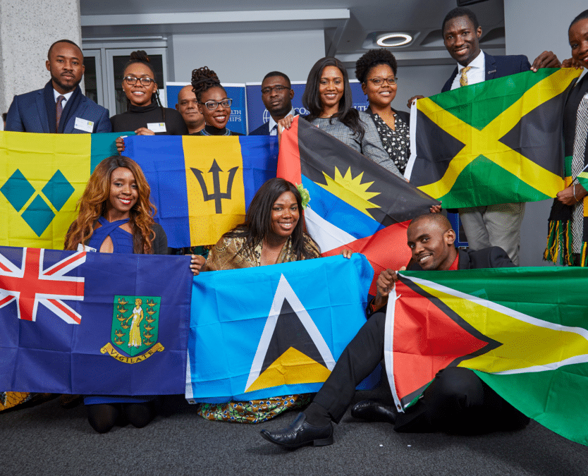
Commonwealth Split-site PhD Scholarships
Support doctoral students enrolled on a PhD programme in their home country to undertake one year of research at a UK institution that has the equipment or expertise they would not otherwise be able to access in their home country.
Split-site PhD Scholarships strengthen existing collaborations and partnerships between universities and research communities.
Application timeline: TBC, likely to be 2026
For more information visit cscuk.fcdo.gov.uk/scholarships/commonwealth-split-site-scholarships-for-low-and-middle-income-countries/

Slide 18
Selection criteria
Applications will be considered on the following criteria:
Candidate Merit (include academic experience)
Quality of the ‘Plan of study’
Impact potential of the candidate’s study to their home country’s development needs
Applicants must submit a complete application, including:
Full transcripts of all higher education listed on their application
At least two references
Supporting statement (PhD applicants only)
You can download a copy of the selection criteria under the ‘Selection process’ information on the programme webpages.

Slide 19
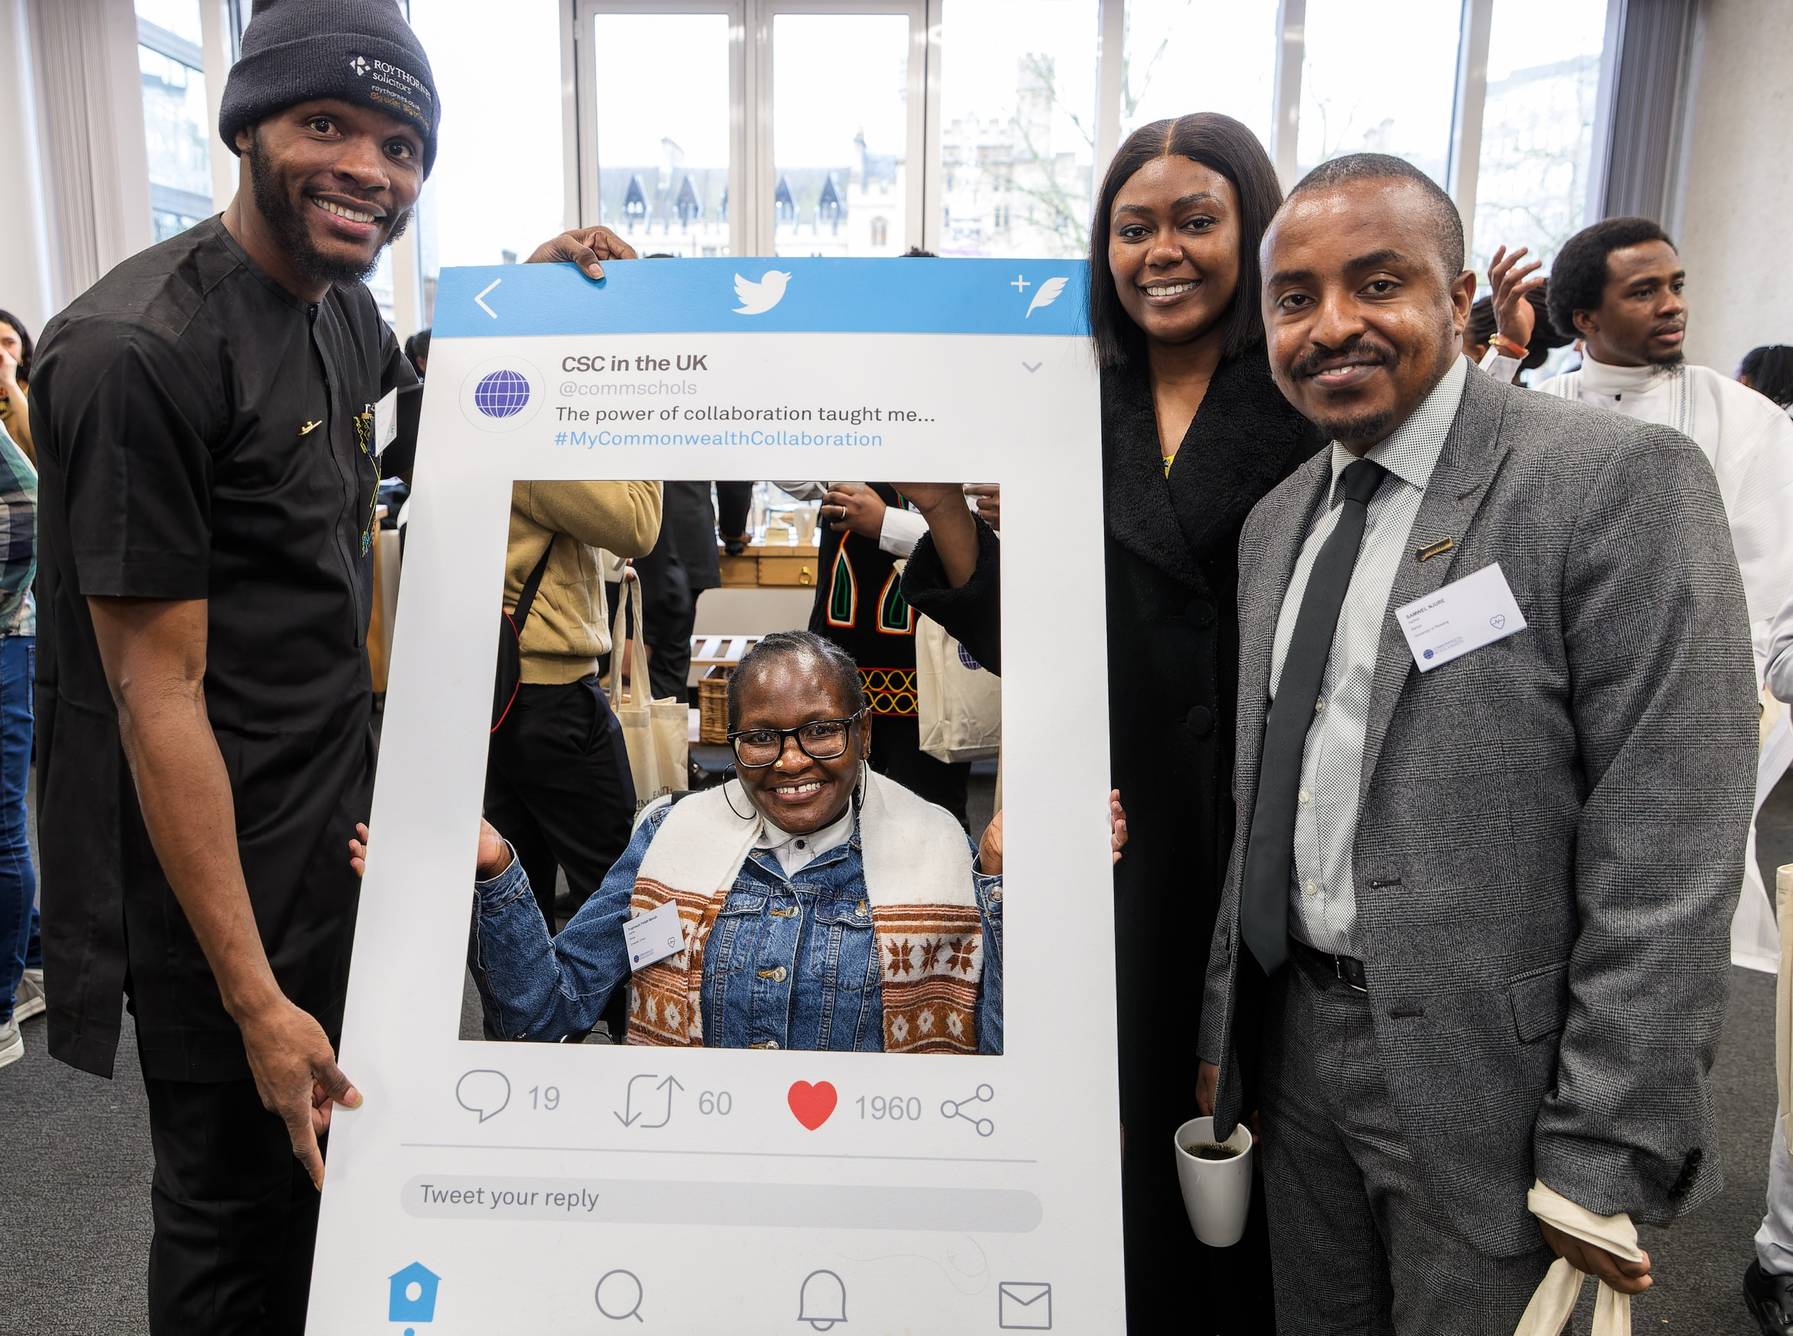
Equal opportunity and access
We continuously work to offer scholarship programmes that serve everyone, regardless of disadvantage or accessibility needs, and including those from historically marginalised groups.
We are committed to a policy of equal opportunity and non-discrimination.
The CSC respects applicant privacy and any information provided to the CSC will be treated in the strictest confidence.

Slide 20
Key links
Find out more
Commonwealth Scholarships and Fellowships available
CSC Development Themes
National, NGO and charitable nominating agencies
Commonwealth Alumni development impact stories
Preparing to apply
Advice for applicants
Frequently Asked Questions (FAQs)
CSC Disability Support Statement

Slide 21
My Commonwealth Scholarship/Fellowship
Notes:
Commonwealth Alumni and CSC Alumni Associations only- please use these slides to share information about your Commonwealth Scholarship or Fellowship journey.
Things to consider:
What were your development goals and how did these relate to your studies?
What did you discover about living and studying in the UK that has had a long-term positive impact on your personal and/or professional development
How has your Commonwealth Scholarship or Fellowship influenced your career and what you are doing?
What is a personal or professional highlight as a result of your Commonwealth Scholarship or Fellowship?
What advice would you give to an applicant thinking about applying for a Commonwealth Scholarship or Fellowship?

