Slide 1
Housekeeping
Do not take screenshots of the presentation or chat box
Do not use any recording software or equipment during the presentation. This includes the use of Artificial Intelligence (AI) technology
Be present and engage with the webinar opportunities, such as live polls, chats, and surveys
Be respectful to others and behave professionally
Do not use foul or offensive language when communicating with fellow attendees and speakers
Do not share weblinks to join the webinar with others. This is a closed webinar for selected participants only.
Your behaviour should not damage the good name of the CSC

Slide 2
2025-2026 CSC Mentoring Programme – introductory webinar for Master’s pairings

Slide 3
Information session overview
Introduction to the programme
How the programme works?
Setting goals
Resources and policies
Q&A

Slide 4
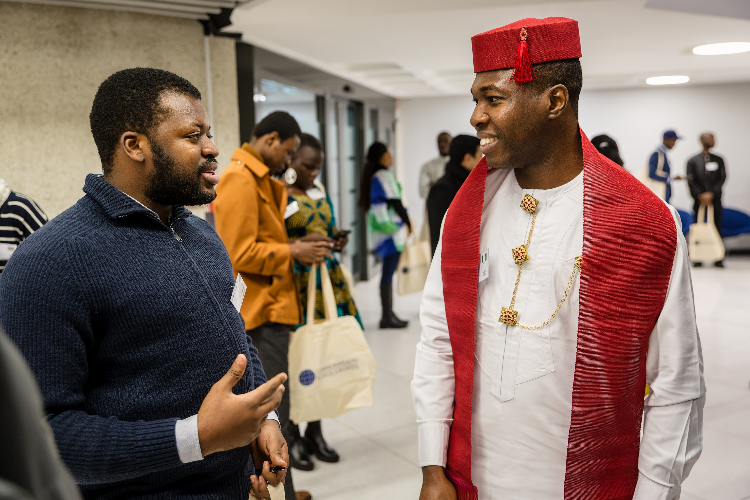
Introduction
  Since 2019, over 1200 Commonwealth Scholars and Alumni have participated in the programme
The programme aims to:
Connect Commonwealth Scholars and Alumni in a 1:1 mentoring pairing
Provide Scholars with advice and guidance on studying and living in the UK
Share knowledge and enhance skills development
Increase understanding of how to achieve development impact post-Scholarship
Develop mentoring and other soft skills

Slide 5
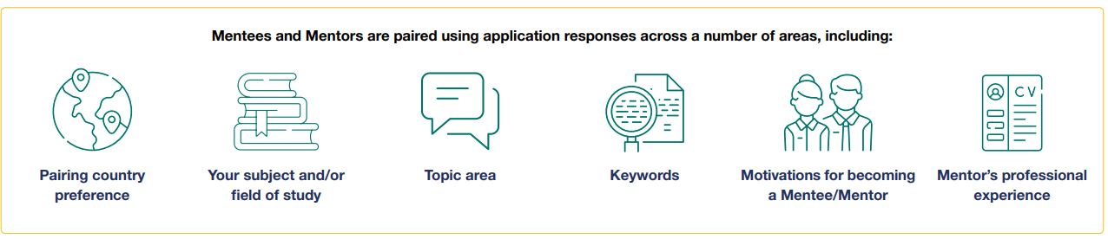
Pairings

Slide 6
How does the programme work for Master’s pairings?

Slide 7

Master’s pairings
One-to-one pairing
Year-long: December 2025 to December 2026
Minimum time commitment: two hours every month
During and post-scholarship mentoring support

Slide 8
Areas of support
Academic support
Professional support
Social support
Think beyond subject area.
Think about your development impact goals.
Think about professional skills.

Slide 9

Roles and responsibilities of Mentors
Support a new Scholar in developing the appropriate skills and knowledge
Share your Commonwealth Scholarship experience
Provide guidance on implementing learning and skills post-Scholarship
Develop your own mentoring and professional skills
Encourage your Mentee to stay connected with the CSC community

Slide 10

Roles and responsibilities of Mentees
Seek guidance on how to ensure your studies will support your development impact goals
Develop your soft skills for personal and professional growth
Ask questions on how to implement learning and skills post-scholarship
Seek support in adjusting to living and studying in the UK
Share updates and keep in regular contact

Slide 11
Five stages

Slide 12
Stage 1: building rapport
December to January
Induction webinar
First introductions initiated by Mentor by 30 November (extended to 7 December)
Get to know each other – work/study, motivations
Share development goals you hope to achieve
Establish expectations
Respond to the first check-in survey by 14 December
Use the mentoring log table template to record your meeting notes
Decide how you will communicate
Mode and frequency of communication
Time zones
Maintain confidentiality
Your pronouns
Communication and neurodiversity

Slide 13
Stage 2: setting SMART goals
💡 Refer to pages 11 of the handbook
February to March
Recommend setting 3-5 goals at the onset of the programme
Mix of short- and long-term goals
Use the SMART goals record to note and track the progress of your goals
Two-way learning process – Mentor’s should set goals
Examples of Mentee and Mentor goals
Specific | Be specific about the end results – what do you want to achieve?
Measurable | Should be measurable to help monitor progress and success
Achievable | Within your capabilities but challenging
Relevant | Is it relevant to what you are trying to achieve?
Timebound | Track your progress, identify milestones or delivery dates

Slide 14
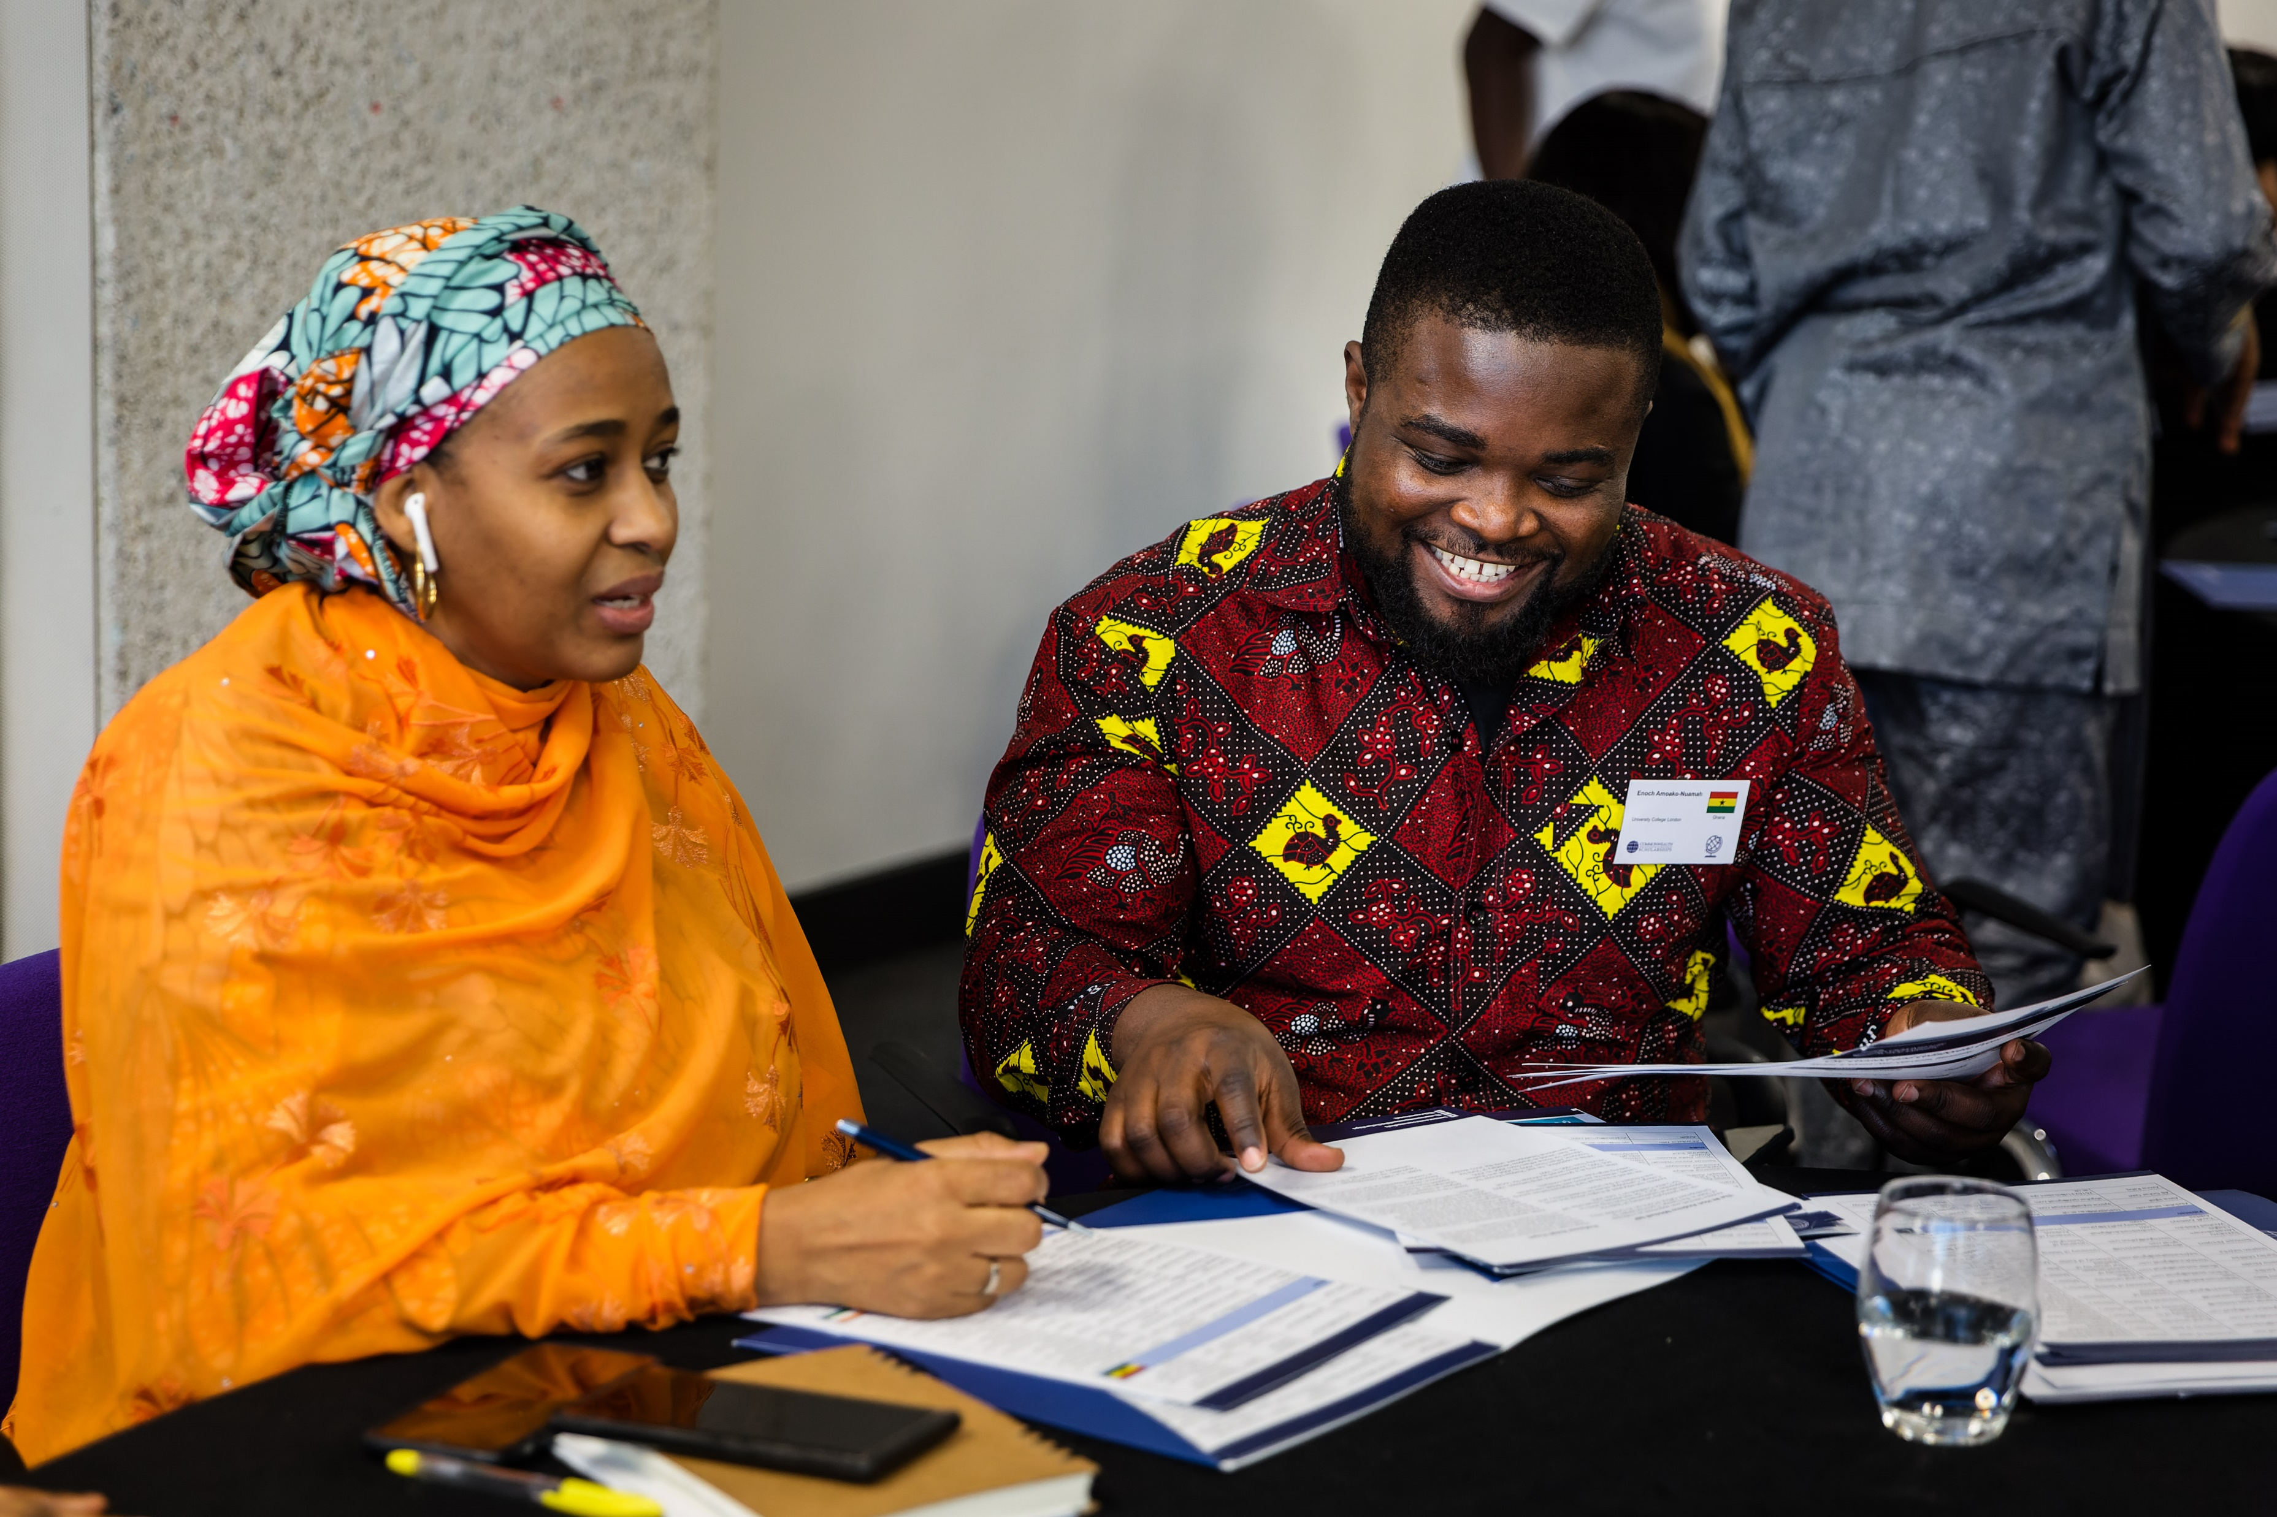
Stage 3: making progress
April to June
Be fully engaged in the programme
Review and evaluate remaining goals
Are your goals still relevant?
Be flexible and self-reflective

Slide 15
Stage 4: discussing future plans
July to September
Prioritise remaining time
Goals around professional development and plans post-scholarship
Professional skills: networking, leadership, critical thinking
Plans post-Scholarship: future studies, new career opportunities
Understand how to implement knowledge and skills post-studies
💡 Tips
Be open to feedback
Busy study period – inform your Mentor

Slide 16

Stage 5: winding down and moving on
October to December
Reflect on your achievements
Any outstanding goals?
Transitioning back home, time zones
Concerns: reverse culture shock, employment, balancing work and family life, future study plans
Professional and personal development
Development impact goals

Slide 17
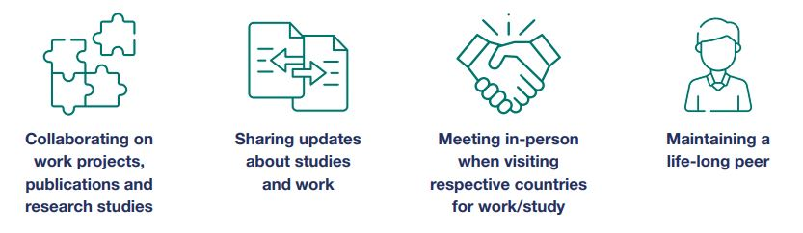
Staying connected post-programme
Benefits

Slide 18
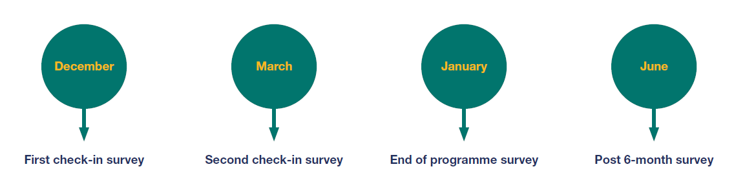
Monitoring and evaluation
The CSC will monitor and evaluate the programme throughout the year

Slide 19
Resources

Slide 20
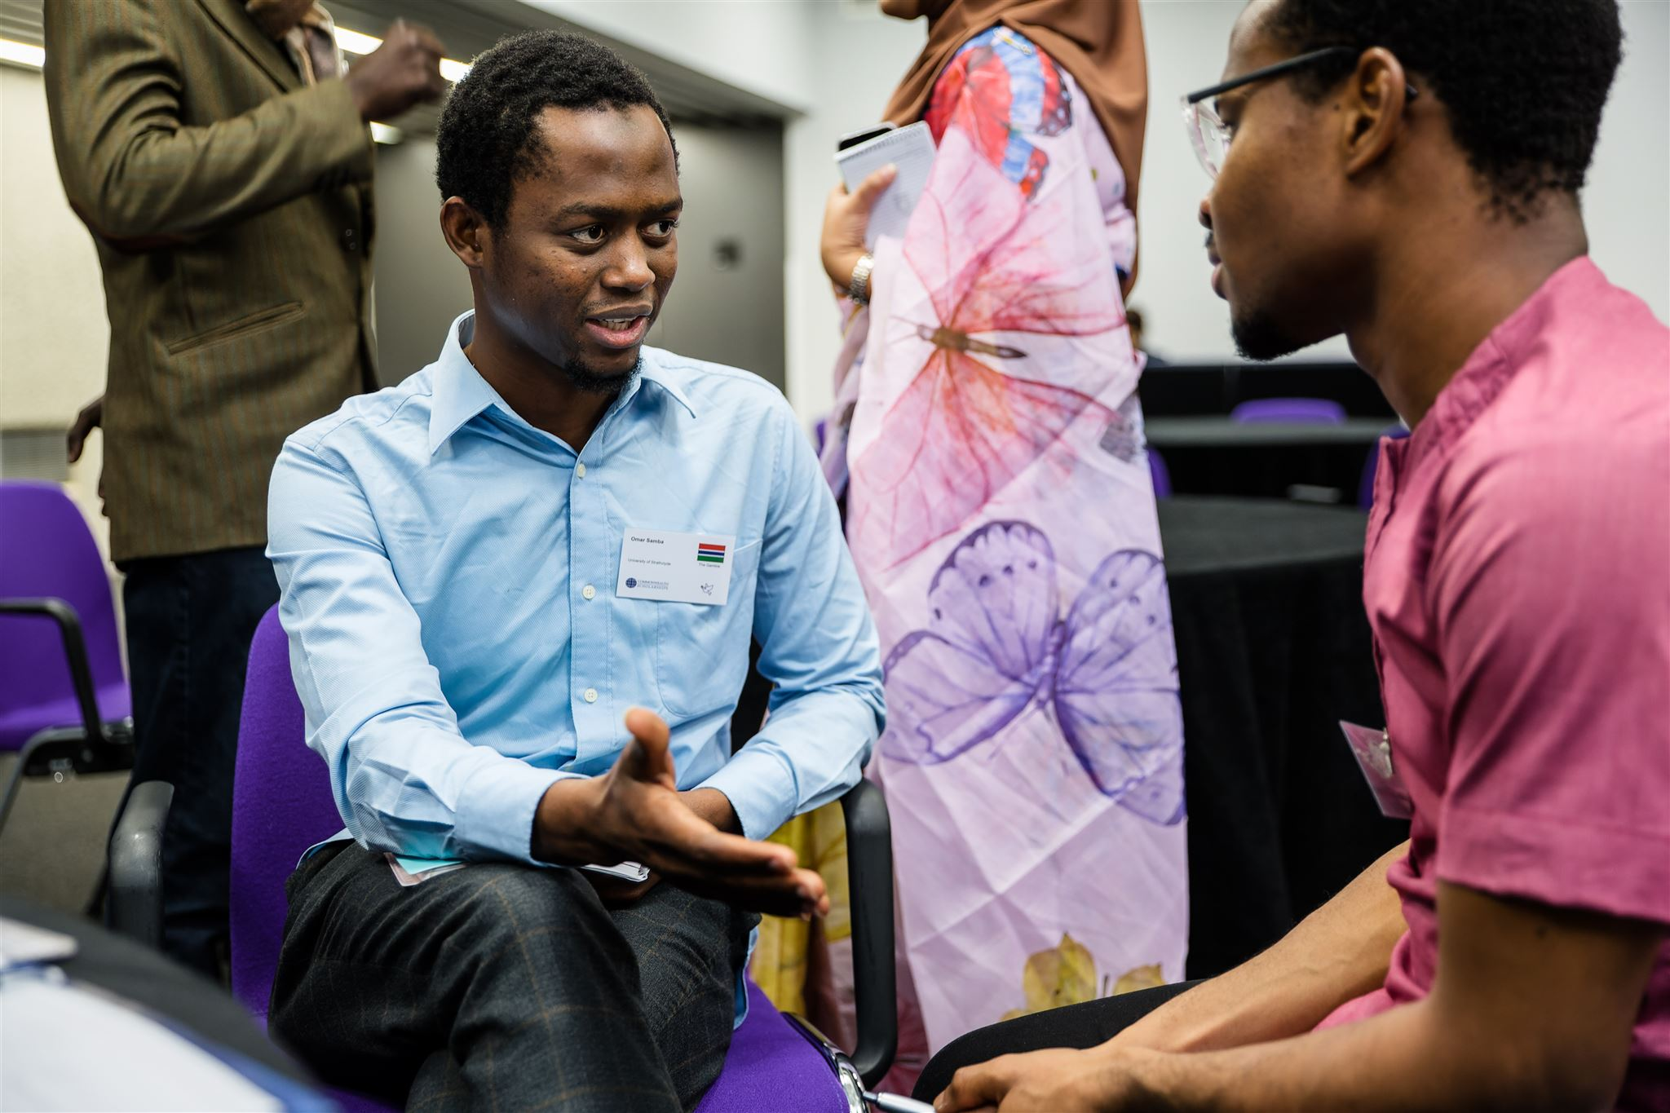
Resources
CSC website
Handbooks
Mentoring log table
SMART goals log
In Handbook:
Top tips
Icebreakers
Effective communication
Receiving constructive feedback
Encouraging your Mentee to be self-reflective
Making the most of your final weeks

Slide 21
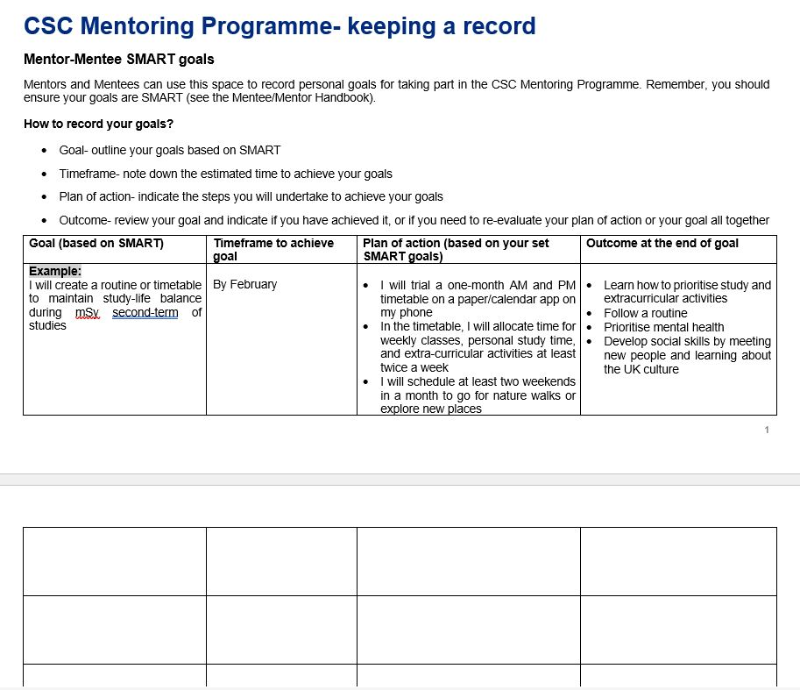
Resources – SMART goals log template

Slide 22
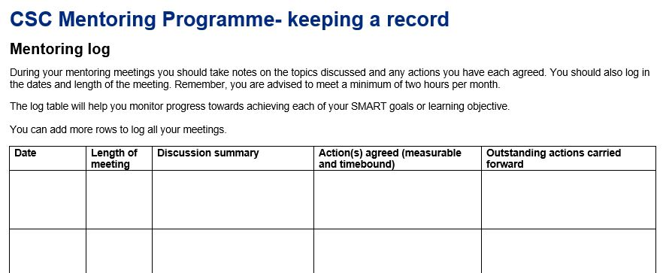
Resources – mentoring log template

Slide 23
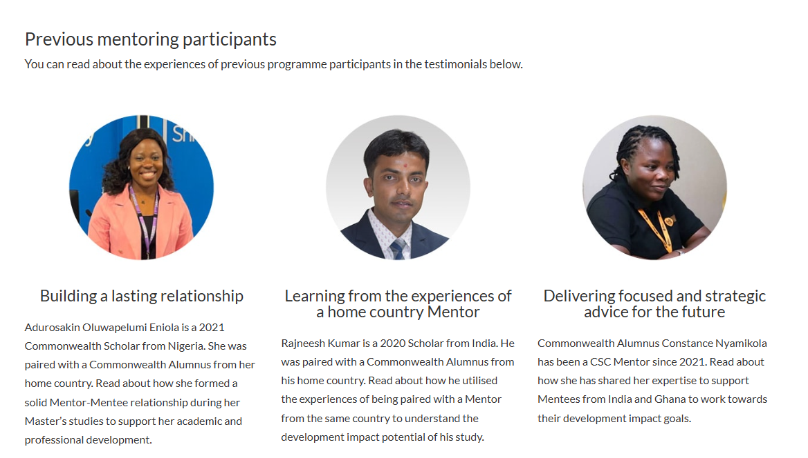
Keep in touch
Email alumni@cscuk.org.uk
Read testimonials on the CSC website:
  cscuk.fcdo.gov.uk/alumni/mentoring-programme/
Refer to the FAQs:
  cscuk.fcdo.gov.uk/csc-mentoring-programme-frequently-asked-questions-faqs/

Slide 24
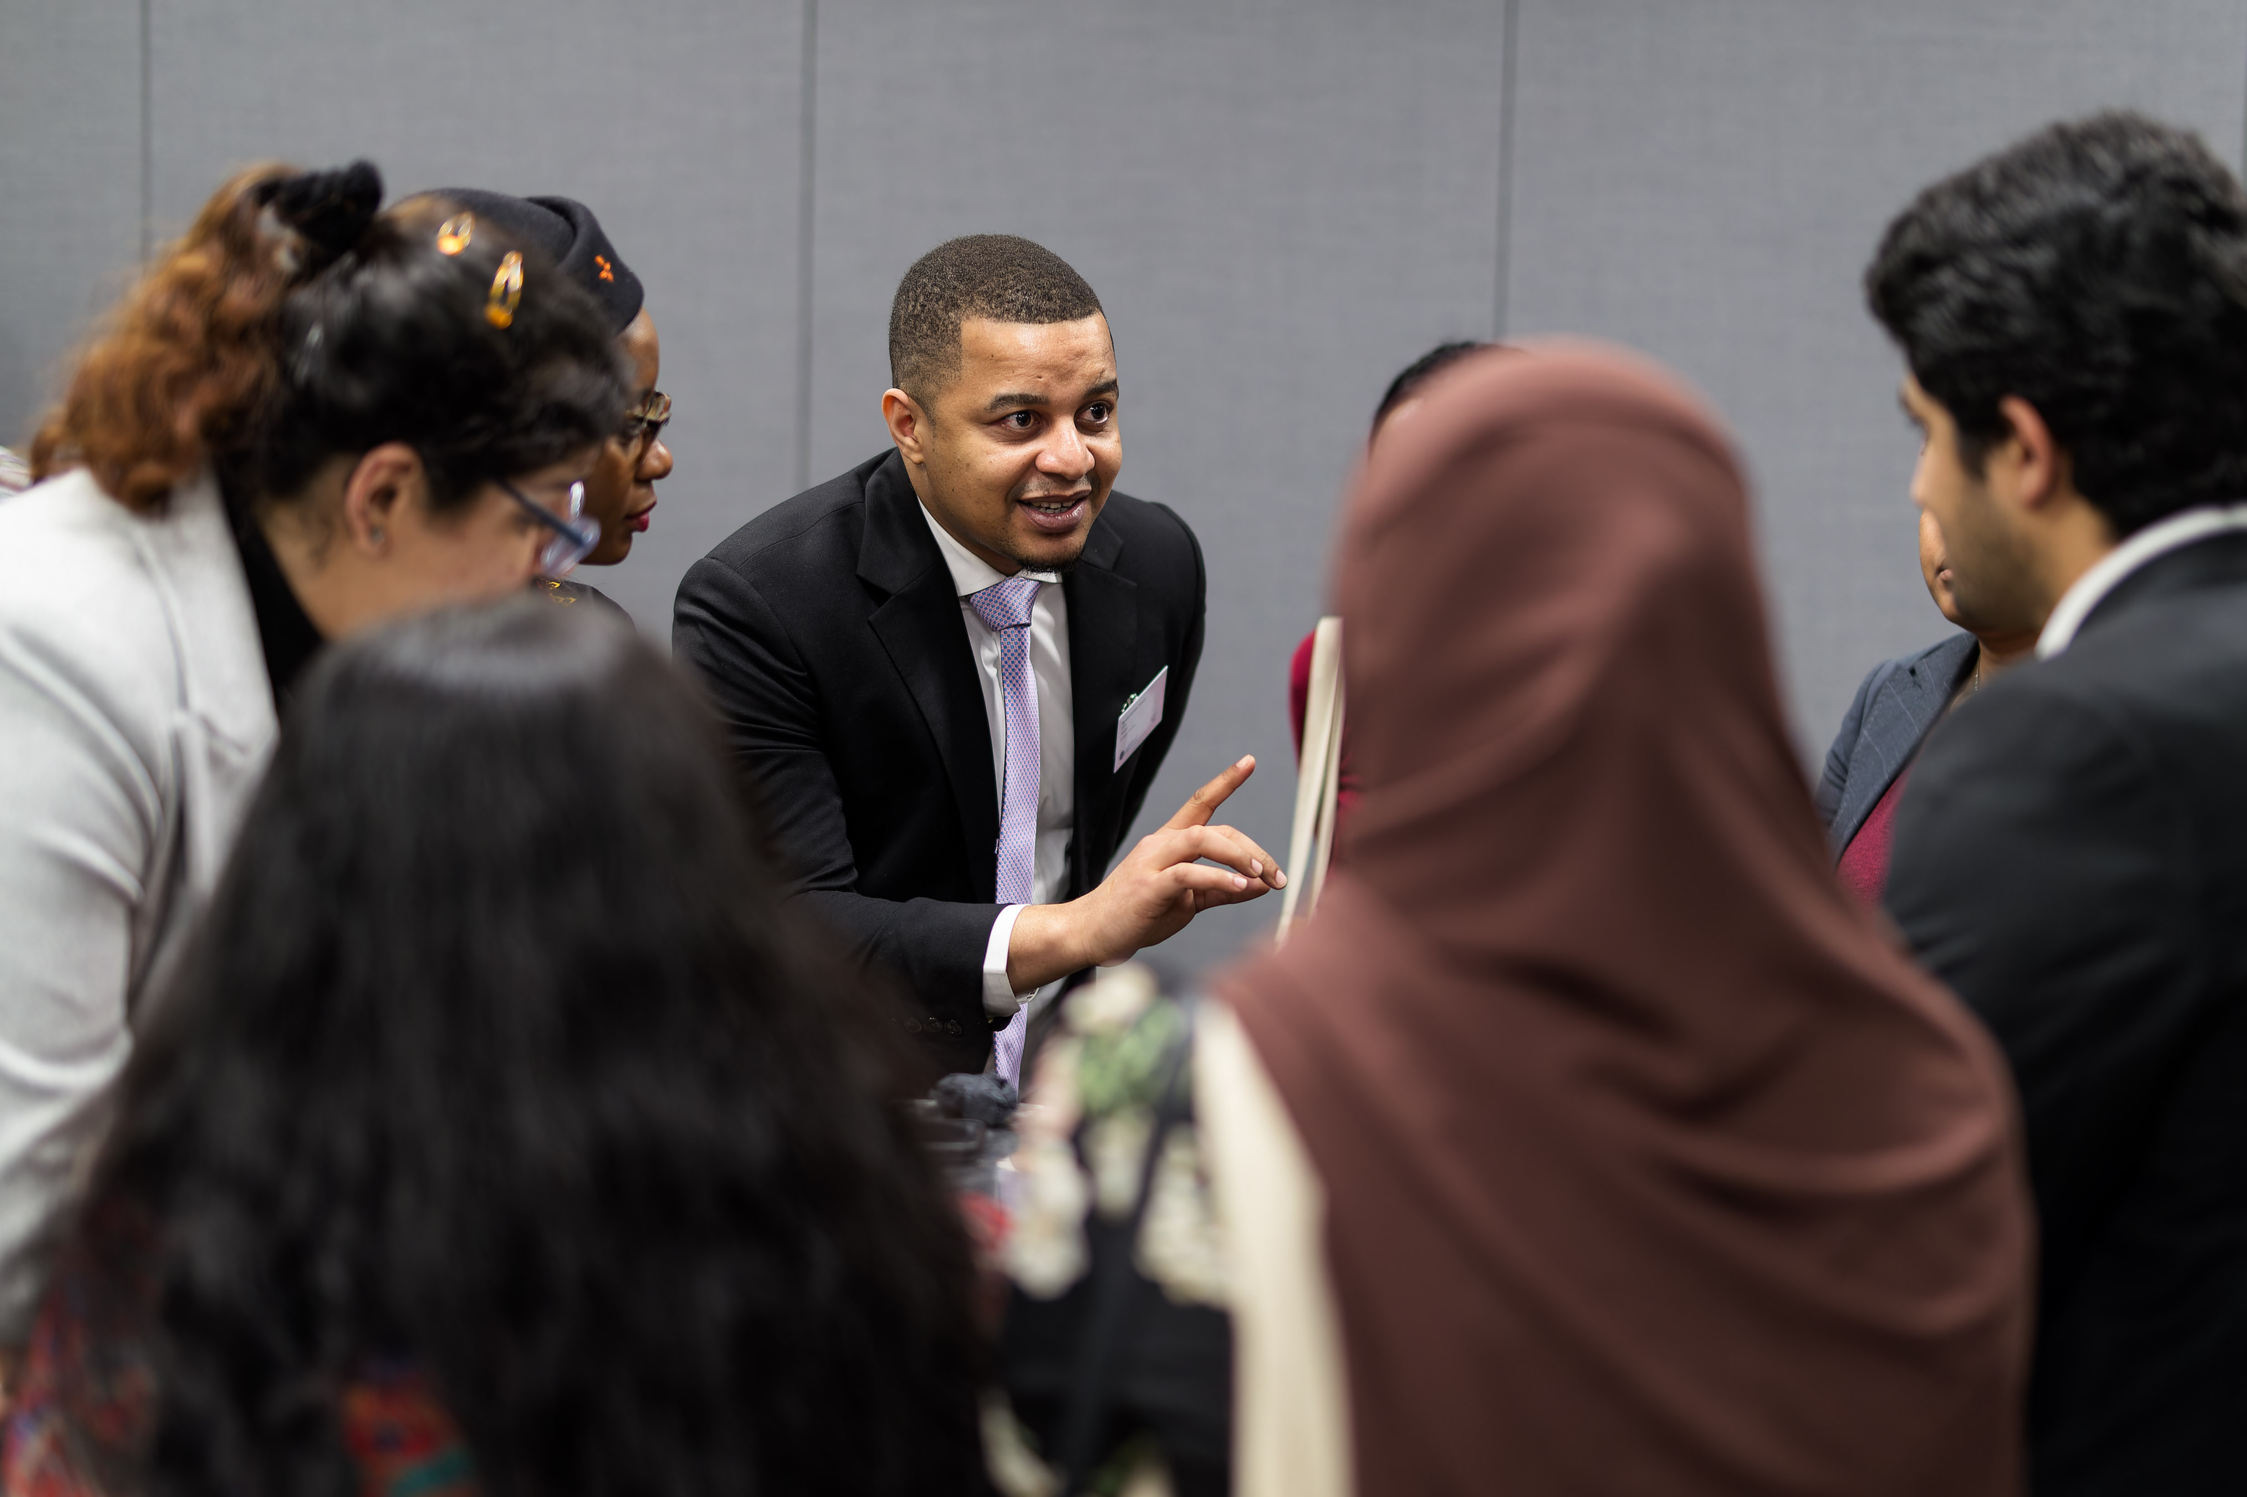
Refer to CSC policies
CSC Code of Conduct
Maintaining confidentiality
Duty to report
CSC Safeguarding policy
Wellbeing and support
Termination of pairings

Slide 25
Additional information
Wellbeing and support
Terminations of pairings
Always keep CSC Alumni Team informed

Slide 26

Keep in touch
Email the CSC Alumni Team: alumni@cscuk.org.uk

Slide 27
Q&A

